Slide 1









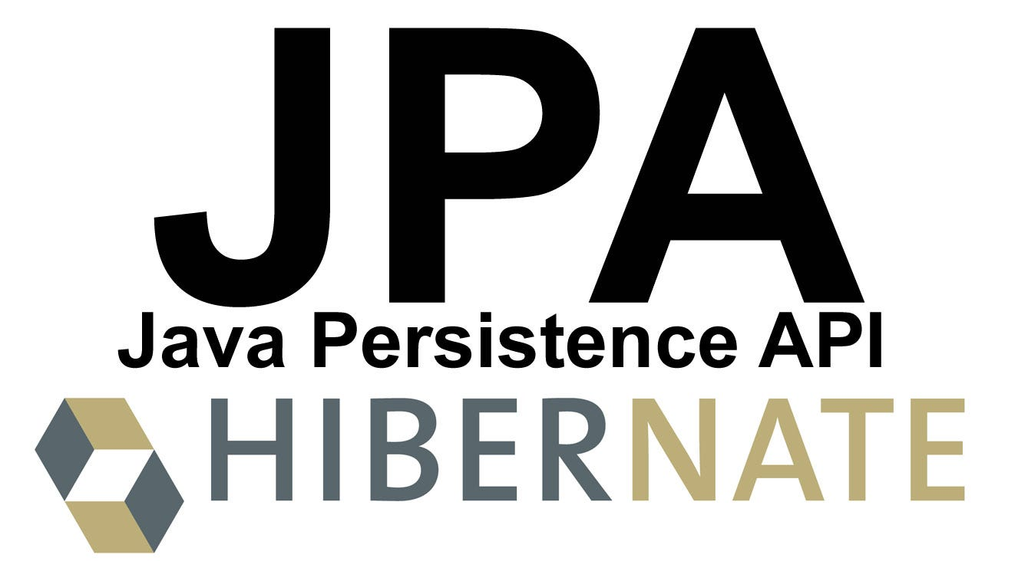




IIT Bombay Internship : 2024-25
Smart Course Management System
Tech Stack
Frontend : ReactJS
Backend : Spring Boot
Presented By : Pabitra Bera

Slide 2








Who I Am: Getting to Know Me
Career Objective
As a recent graduate with handson experience in Java development, including Spring Boot and ReactJS, I am seeking an entrylevel position where I can leverage my skills to contribute to innovative software solutions. My goal is to grow as a developer while working on challenging projects that drive technological advancements.
About Me
Wrok Experience
Education
I am Pabitra Bera, a dedicated Java Developer with handson experience in Spring Boot and ReactJS. My internship at Oasis Infobyte equipped me with practical skills in developing scalable applications, and I am eager to contribute to innovative software solutions.
Role : Java Developer Intern
Company : Oasis Infobyte
Duration : June 2024-July 2024
Degree : B.Tech
Institution : KIST,BPUT
Graduation : 2020-24
Major : CSE
Skills
Certifications
Achievements
Languages : Java
Frameworks : Spring Boot, ReactJS
Concepts :
Microservices,
REST APIs,
OAuth2 , OIDC
VC : Git
Letter of Recommendation
Star Performer Recognition
REST API usingSpring (Infosys)
Spring Boot Beginner to Expert (Infosys)
Spring Boot Advanced Microservices & Securing Web Application (Infosys)
Spring Boot with JWT (AliBou Coding)
Handson Spring Boot Framework (AliBou Coding)
Projects
Train Ticket Manamgement
Online Exam
Course Management

Slide 3

API Implementation Overview
AuthService
AuthController: Handles authentication and authorization, using JWT for secure and stateless user sessions.
UserService
UserController: Manages user profiles, and rolebased access control.
CourseService
CourseController: Enables CRUD operations for course entities, ensuring efficient management , retrieval of course data and rolebased access control.
InstanceService
InstanceController: Facilitates the creation and management of course instances, linking them with their respective courses and rolebased access control.

Slide 4
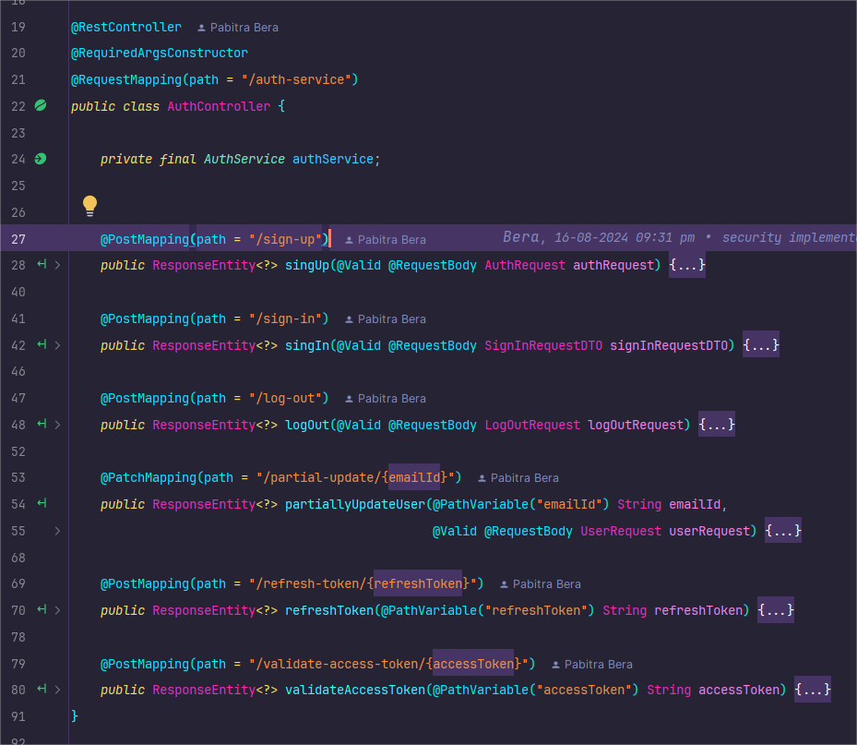

Slide 5
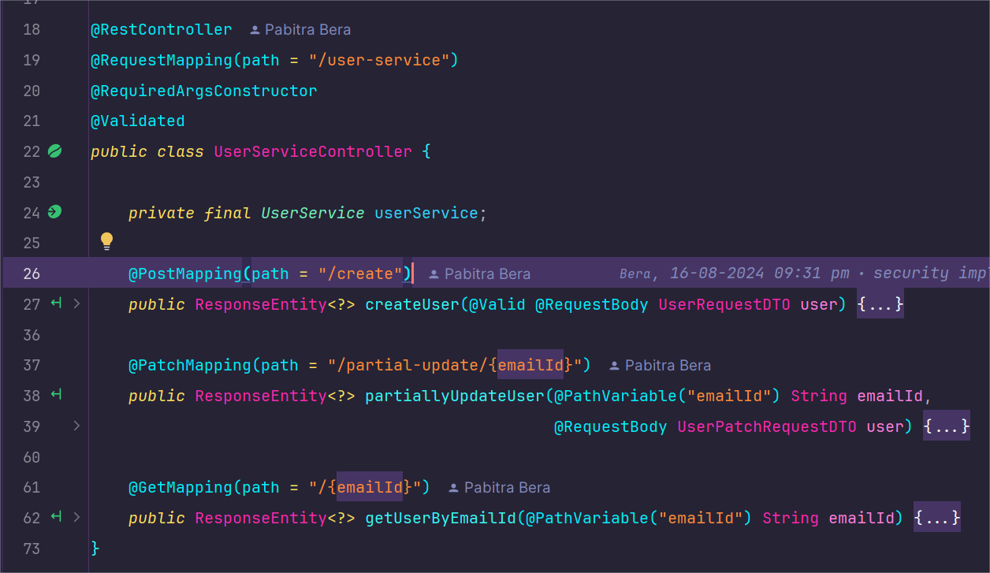

Slide 6
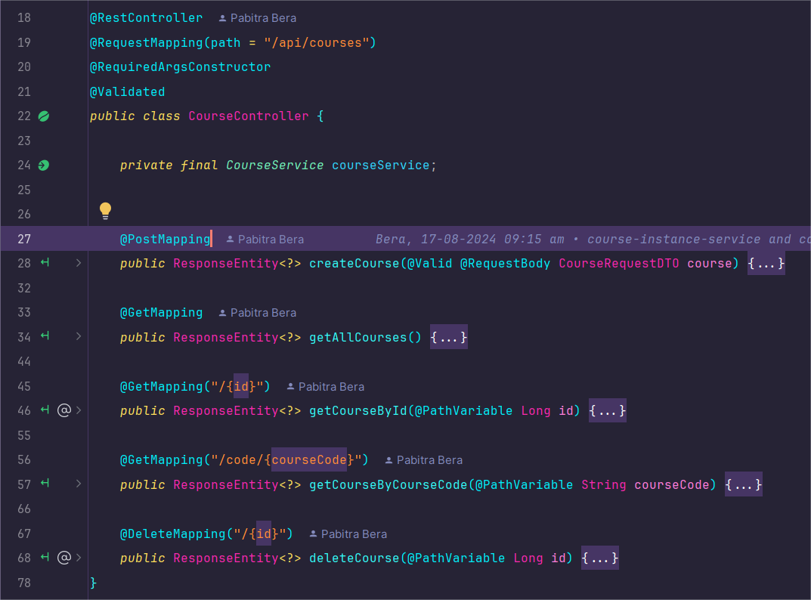

Slide 7
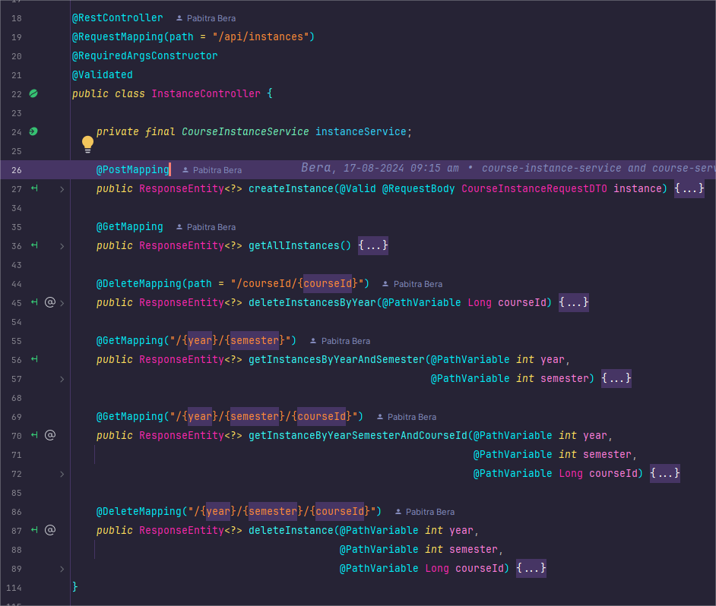

Slide 8

Validation Highlights
AuthService
Full Name: Must not be blank
Email: Must be valid and not blank
Phone Number: `10-13` digits, optional '+' prefix.
Password: Minimum 8 characters, with upper & lower case, digit, special character, no spaces.
Roles: Cannot be empty or blank & must include either ADMIN, USER, or both. No other roles are allowed.
SignIn Request: Valid email & password required, no blanks.
Log Out Request: Valid email and wellformed JWT access token.
UserService
Full Name: Must not be blank
Email: Must be valid and not blank
Phone Number: `10-13` digits, optional '+' prefix.
Password: Minimum 8 characters, with upper & lower case, digit, special character, no spaces.
Roles: Cannot be empty or blank & must include either ADMIN, USER, or both. No other roles are allowed.
CourseService
Title: Cannot be blank.
Description: Cannot be blank.
Course Code: Must start with two uppercase letters, followed by a space and a number.
InstanceService
Year: Cannot be null and must be a positive number.
Semester: Cannot be null and must be between 1 and 10.
Course ID: Cannot be null and must be a positive number.

Slide 9
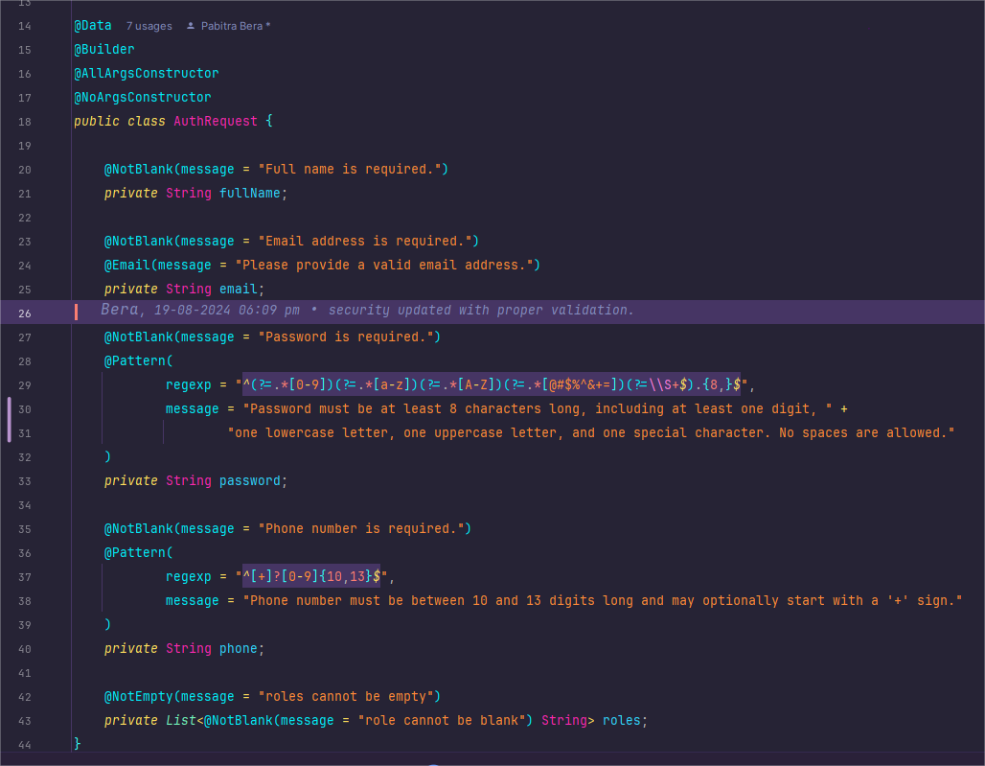

Slide 10
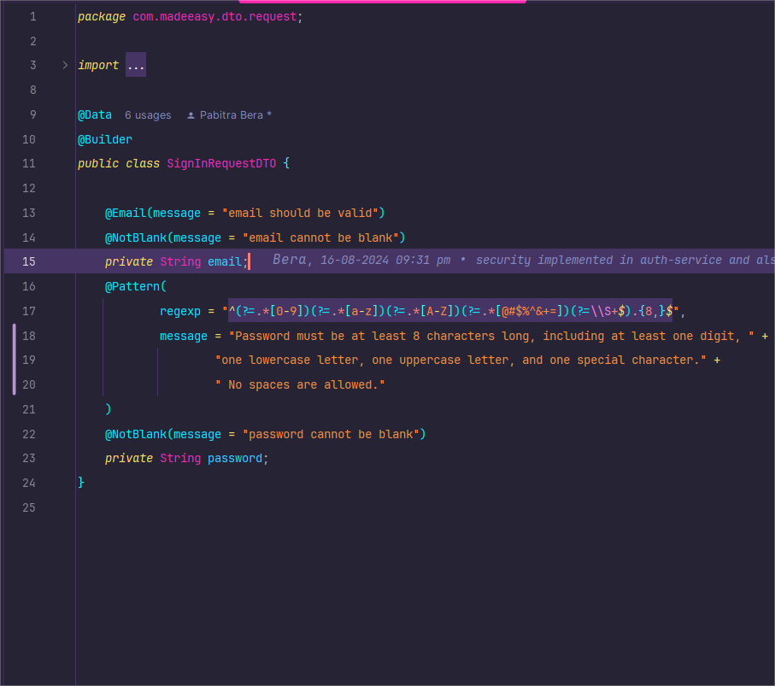

Slide 11
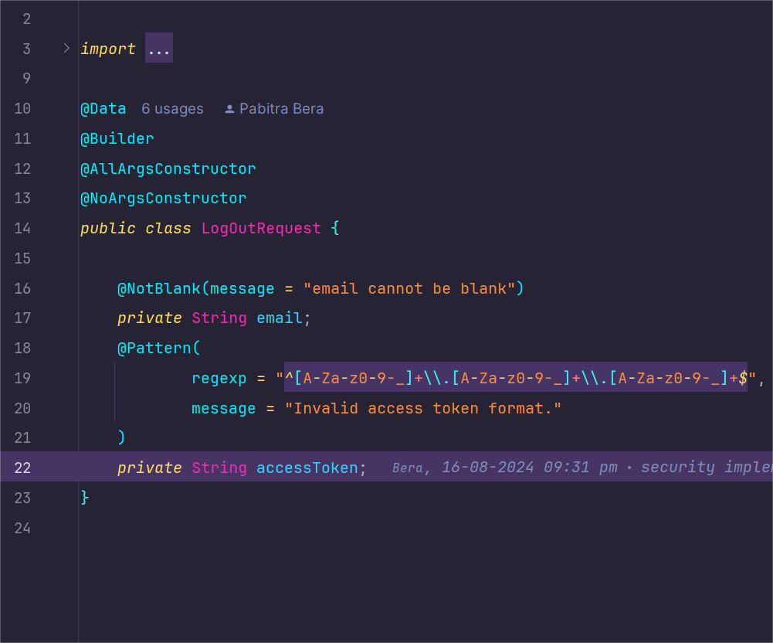

Slide 12
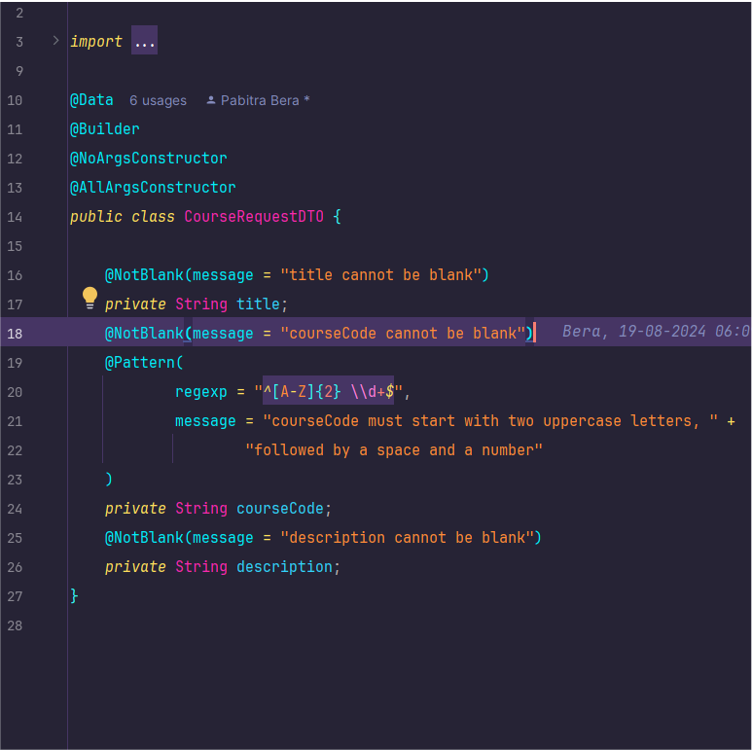

Slide 13
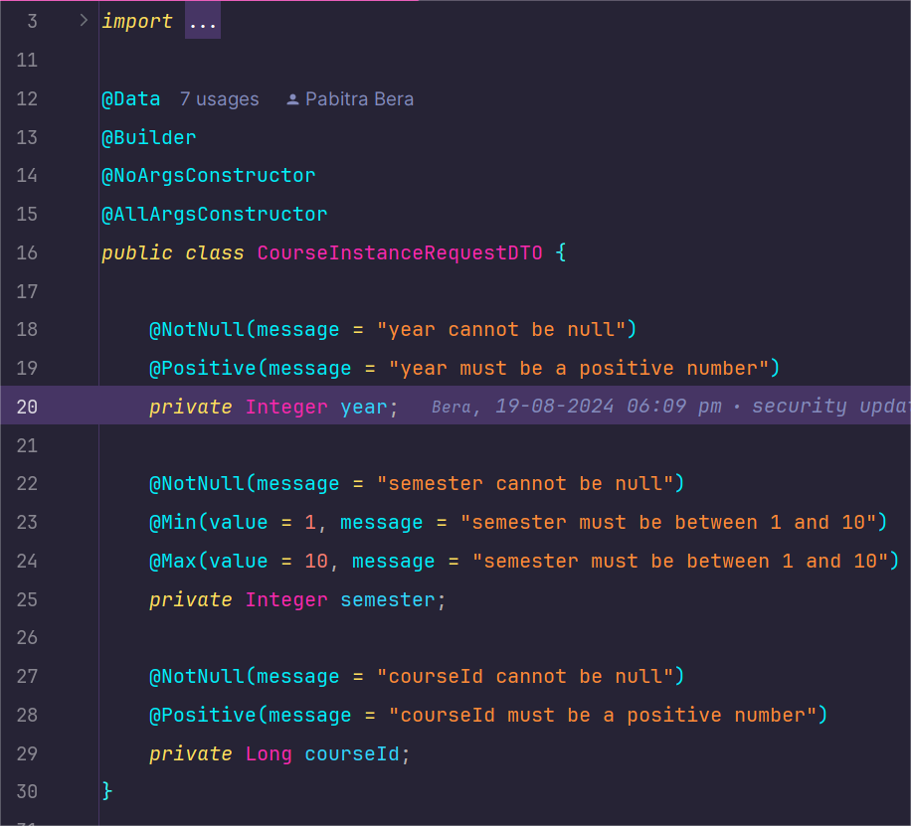

Slide 14

Validation Testing with Postman
AuthService
Payload Validation: Ensured all incoming requests are validated for required fields (full name, email, password, phone) before processing.
Constraint Enforcement: Applied strict validation rules for roles and data formats to prevent invalid data from being processed.
UserService
Input Validation: Validated user payloads for completeness and correctness (e.g., name, email, password, phone) prior to any logic execution.
Error Handling: Checked for accurate error responses if payloads do not meet validation criteria.
CourseService
Data Integrity: Confirmed that course payloads (title, course code, description) are validated against business rules before any processing occurs.
Format Validation: Ensured course code and description formats are correct to maintain data consistency.
InstanceService
Request Validation: Validated all course instance data (year, semester, course ID) to meet predefined constraints before further processing.
Boundary Checks: Implemented checks for valid ranges and positive numbers to prevent erroneous data from being processed.

Slide 15
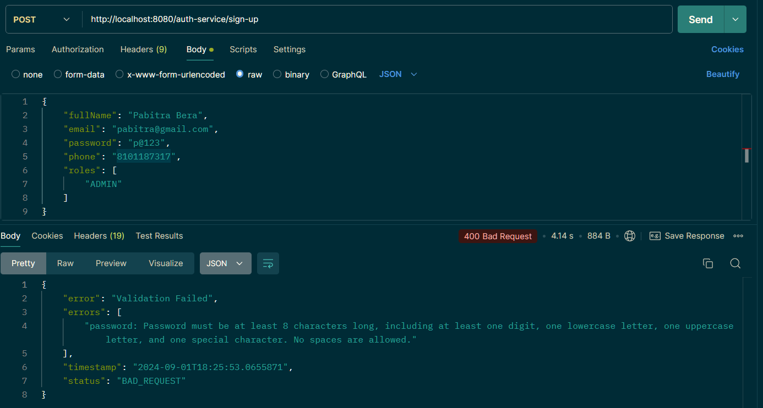

Slide 16
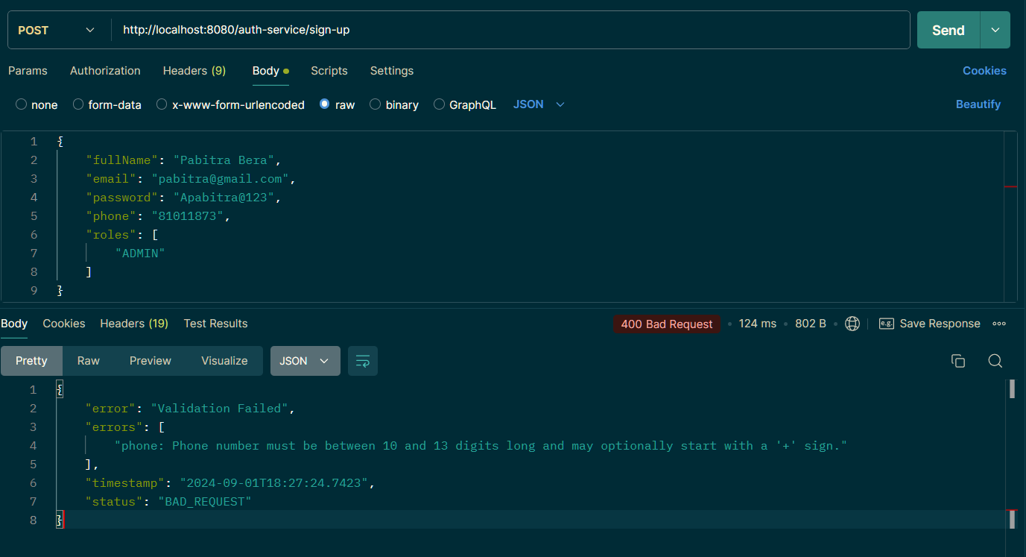

Slide 17
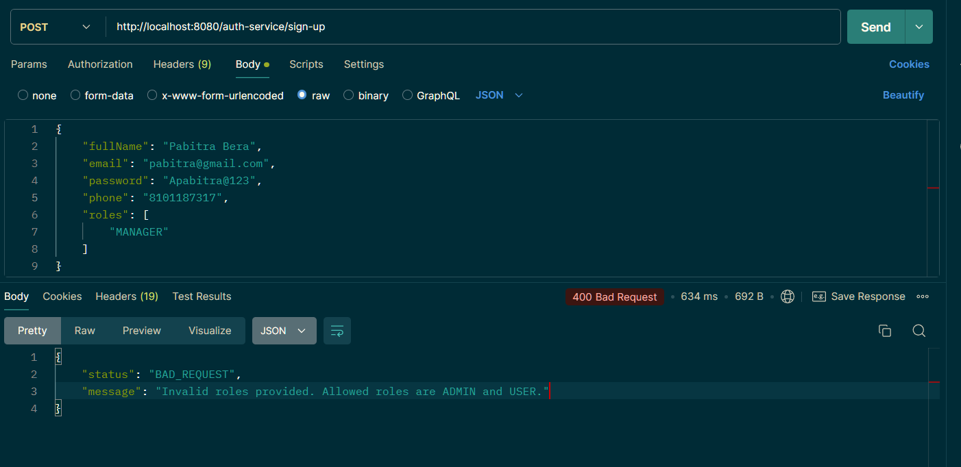

Slide 18
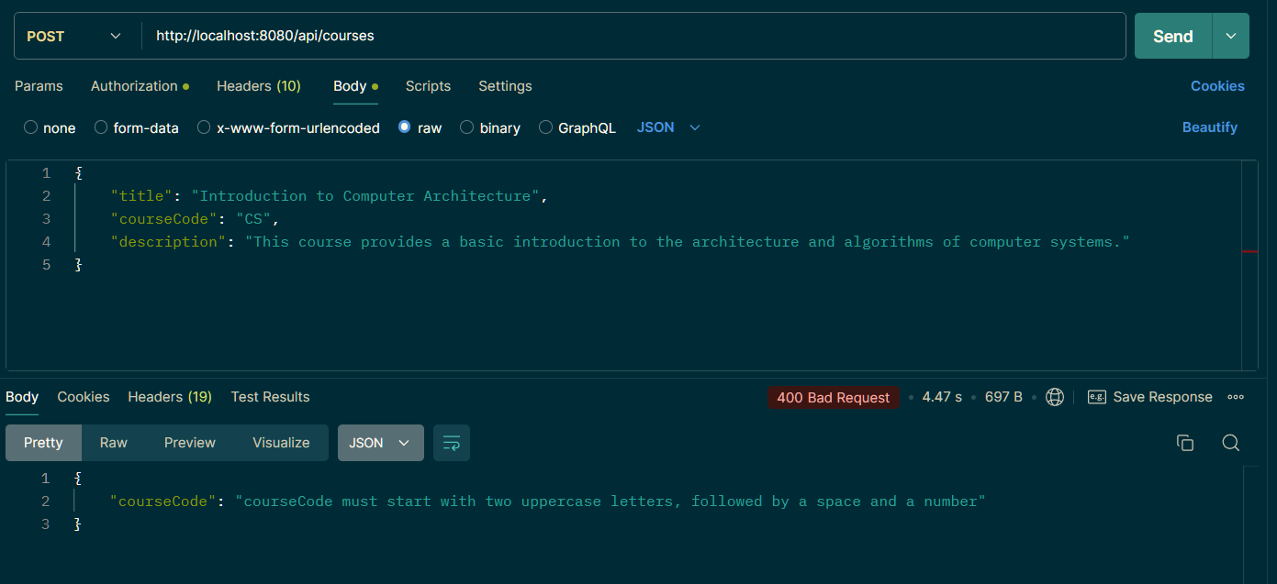

Slide 19
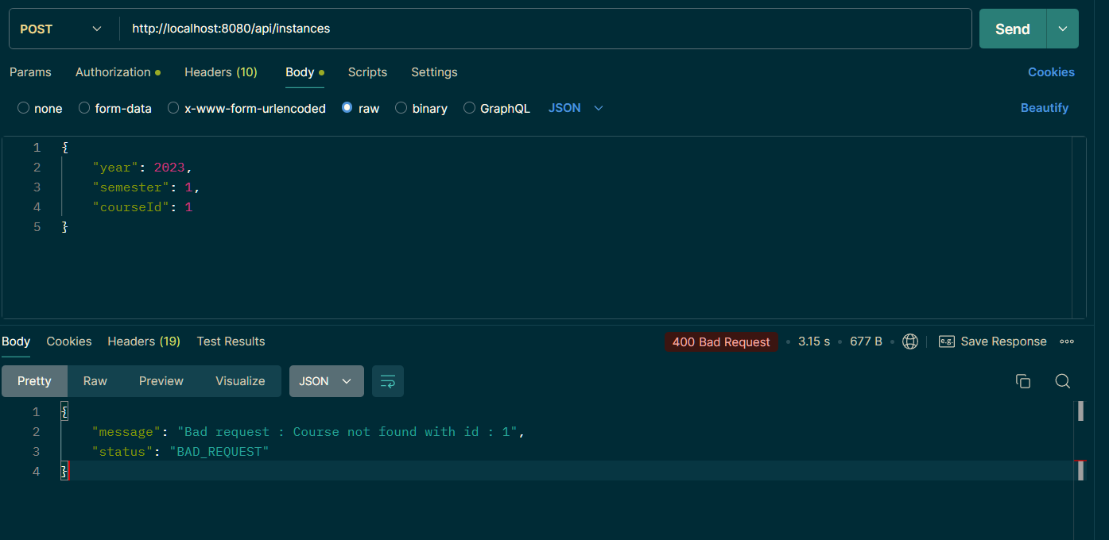

Slide 20
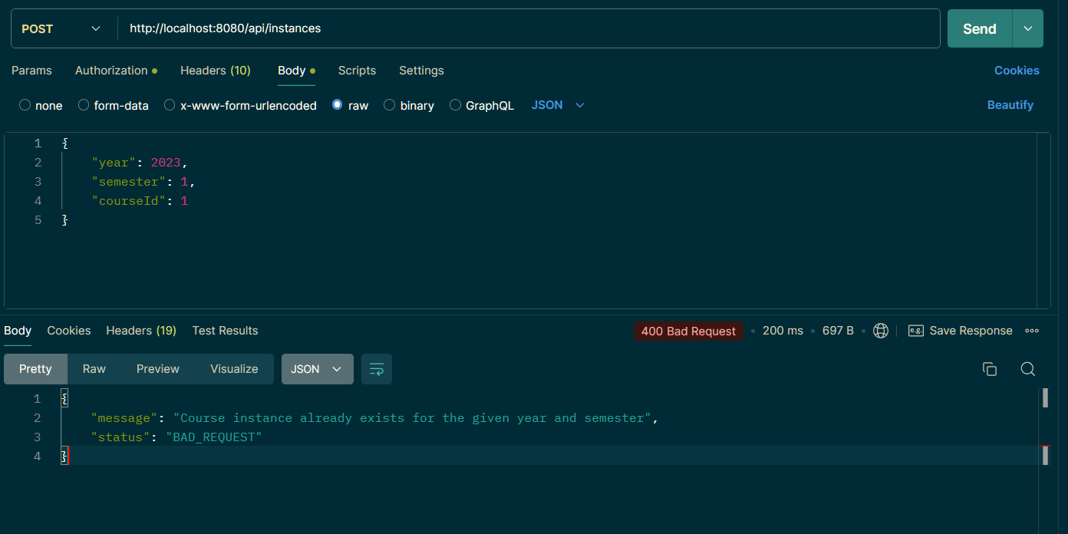

Slide 21
Eureka Server Overview
Service Registry: Eureka Server acts as a central registry for microservices, enabling service discovery and registration.
Dynamic Scaling: Supports automatic detection of new services and updates, facilitating dynamic scaling and load balancing.
Heartbeat Mechanism: Monitors the health of registered services through periodic heartbeats, ensuring only healthy instances are used.
Failover Management: Provides robust failover handling by removing stale instances and rerouting traffic to available services.
ClientSide Load Balancing: Integrates seamlessly with clientside load balancing, ensuring efficient request distribution among service instances.
UserFriendly Dashboard: Offers a webbased dashboard for monitoring service registrations and instance status in realtime.

Slide 22
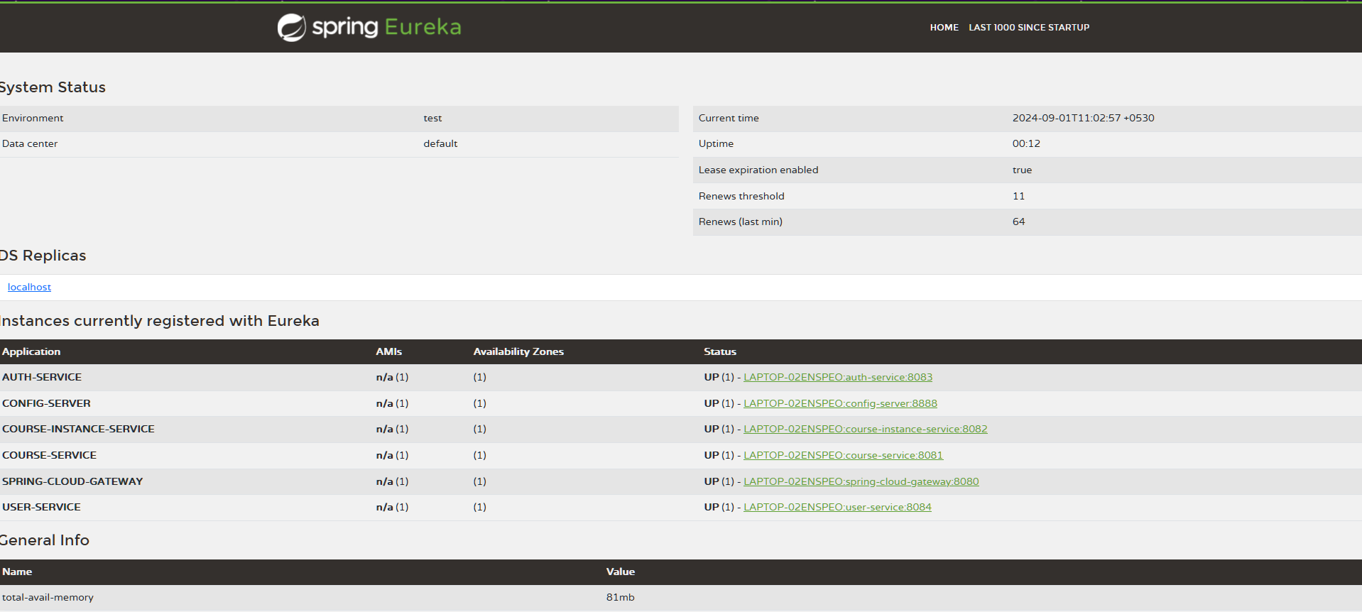

Slide 23
AuthService Endpoint Functionality Testing
Endpoint Validation: Ensuring that all authentication endpoints process requests accurately, with comprehensive validation of user data (e.g., registration, login, logout).
Response Verification: Confirming that each endpoint returns the correct HTTP status codes, such as 200 OK for successful operations and 400/401 for validation or authentication failures.
Error Handling: Testing to ensure proper error messages and responses are provided for invalid or incorrect inputs, enhancing the robustness of the AuthService.
Security Checks: Verifying that sensitive operations like login and logout are securely handled with correct token management.

Slide 24
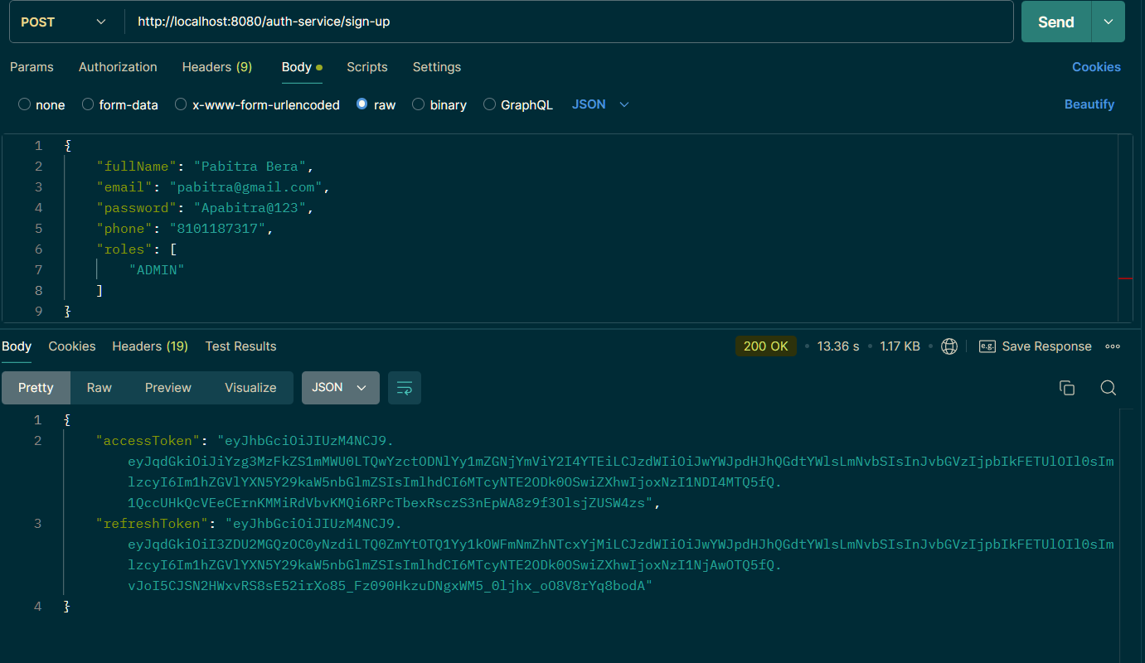

Slide 25
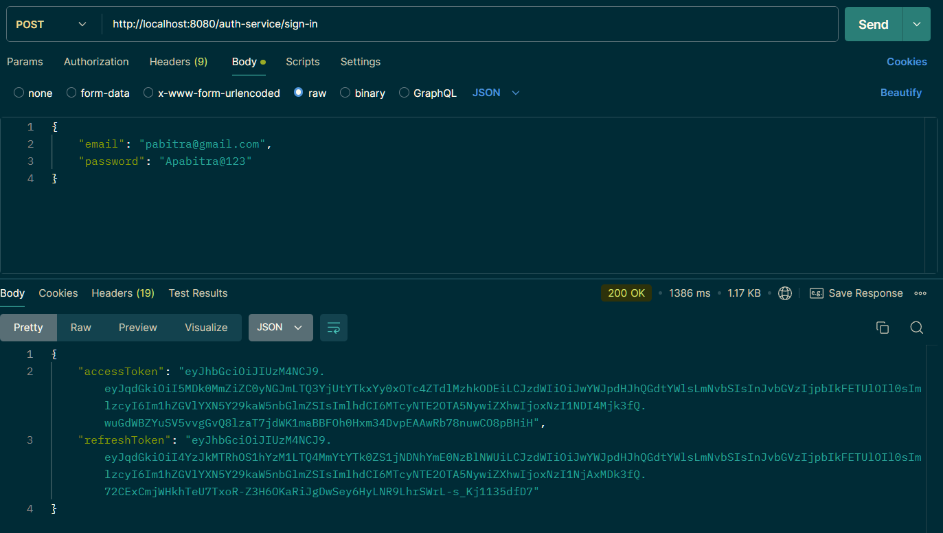

Slide 26
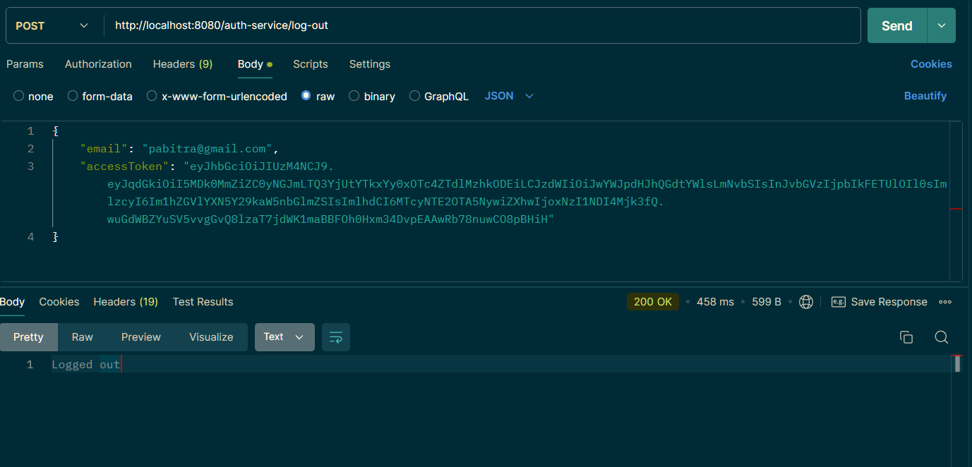

Slide 27
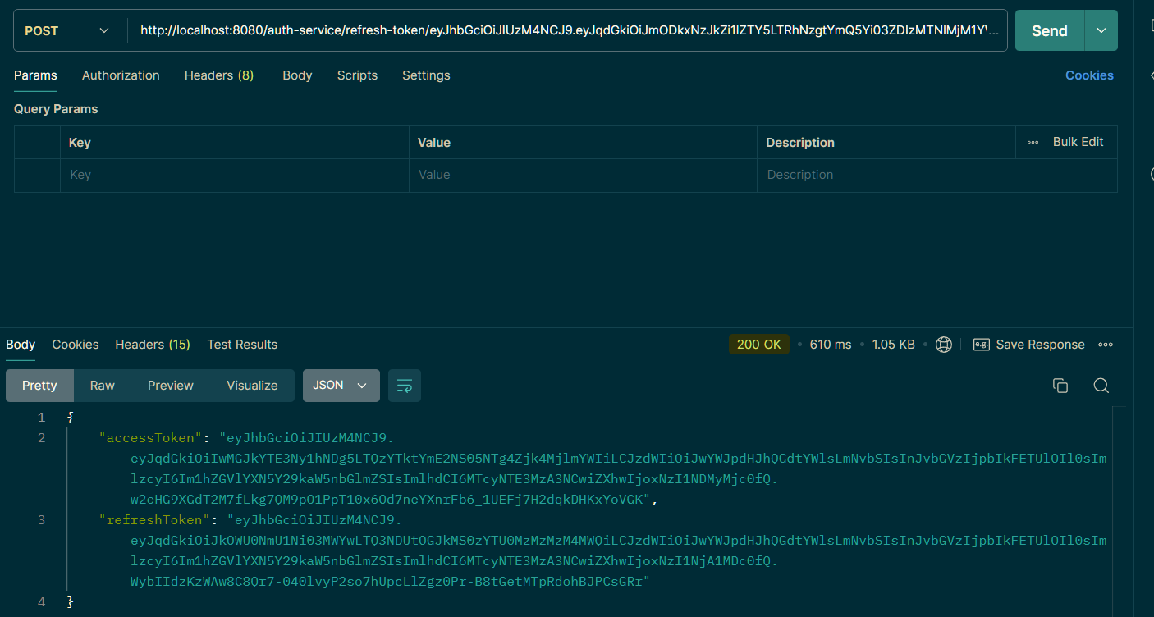

Slide 28
UserService Endpoint Functionality Testing
Endpoint Validation: Ensuring that all userrelated endpoints (e.g. profile update, user retrieval) handle requests accurately with complete validation of user data (e.g., fullName, email, password,etc).
Response Verification: Confirming that each endpoint returns correct HTTP status codes, such as 200 OK for successful operations and 400/404 for validation or not found errors.
Error Handling: Verifying that appropriate error messages and responses are given for invalid or incomplete user data, enhancing the service’s reliability.
Security and Privacy: Ensuring that sensitive user information is securely processed and managed, including proper handling of authentication and authorization.

Slide 29
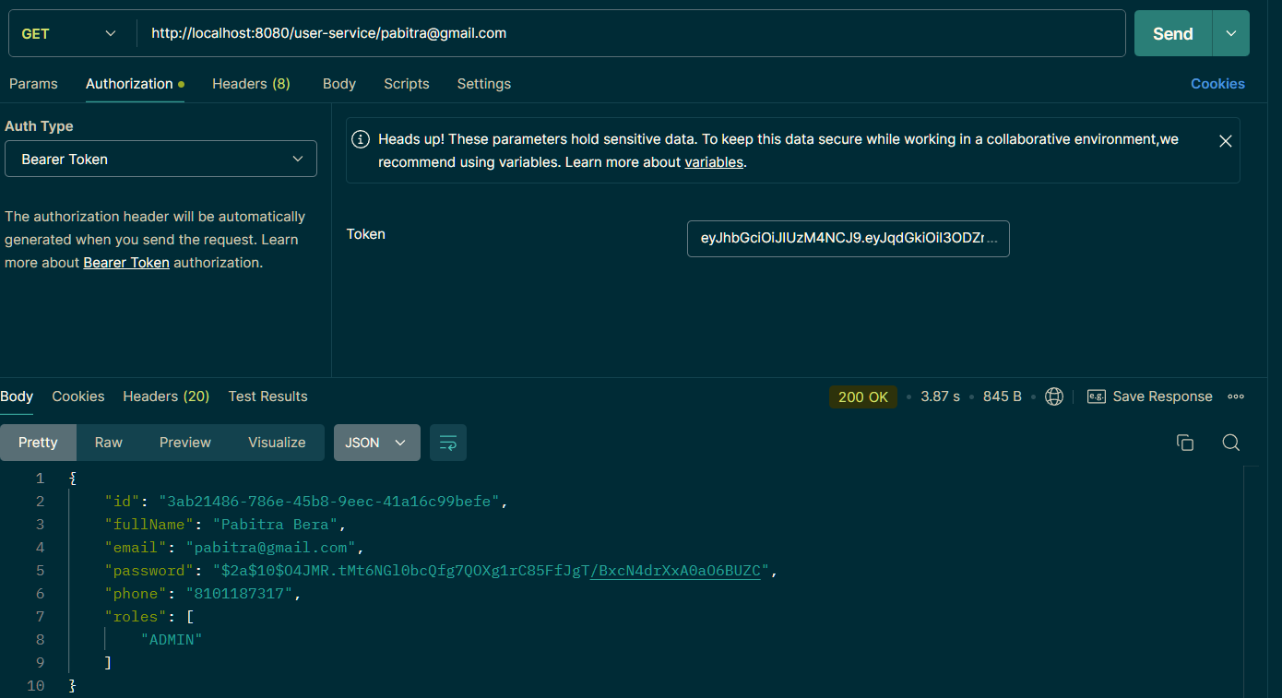

Slide 30
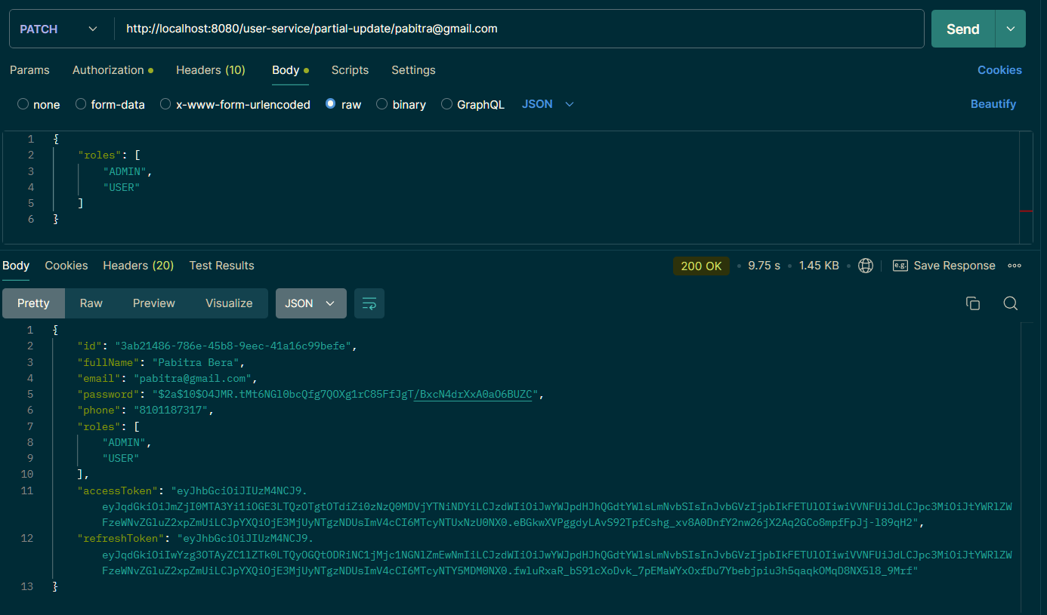

Slide 31
CourseService Endpoint Functionality Testing
Endpoint Validation: Ensuring that all courserelated endpoints (e.g., course creation, retrieval, deletion) accurately process requests with comprehensive validation of course data (e.g., title, courseCode, description).
Response Verification: Confirming that each endpoint returns appropriate HTTP status codes, such as 200 OK for successful operations and 400/404 for validation or not found errors.
Error Handling: Testing to ensure that accurate error messages and responses are provided for invalid or incomplete course data, improving the service's reliability.
Data Integrity: Validating that course data is consistently processed and stored correctly across the service.

Slide 32
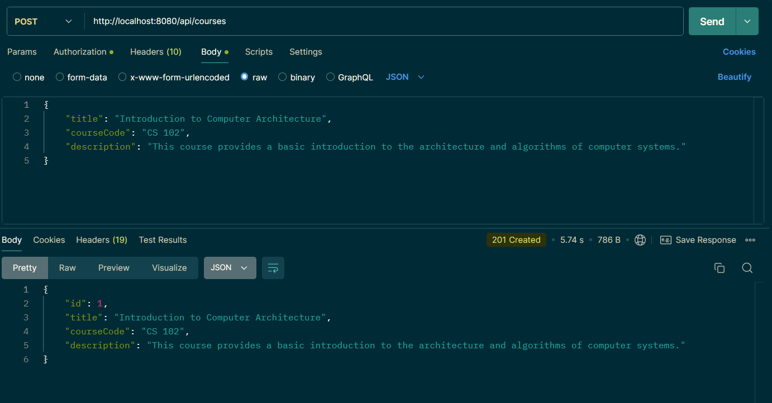

Slide 33
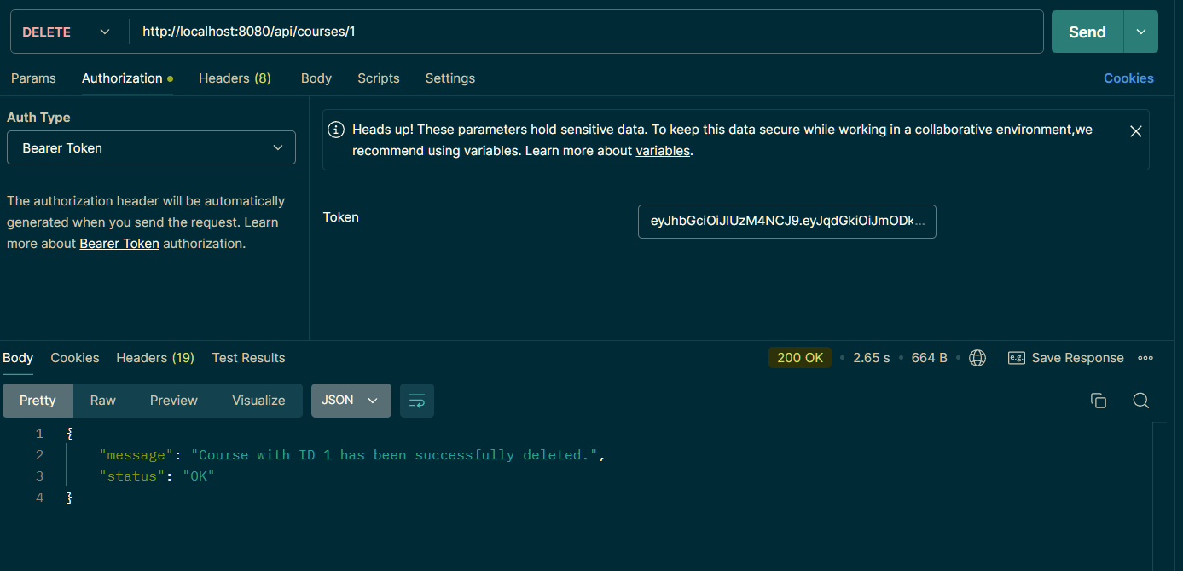

Slide 34
InstanceService Endpoint Functionality Testing
Endpoint Validation: Verifying that all instancerelated endpoints (e.g., instance creation, retrieval,deletion) accurately process requests with validation of instance data (e.g., year, semester, courseId).
Response Verification: Ensuring correct HTTP status codes are returned, such as 200 OK for successful operations and 400/404 for validation or not found errors.
Error Handling: Confirming that proper error messages are provided for invalid or missing instance data, enhancing the service's robustness.
Data Consistency: Ensuring that instance data is processed and maintained consistently across the service.

Slide 35
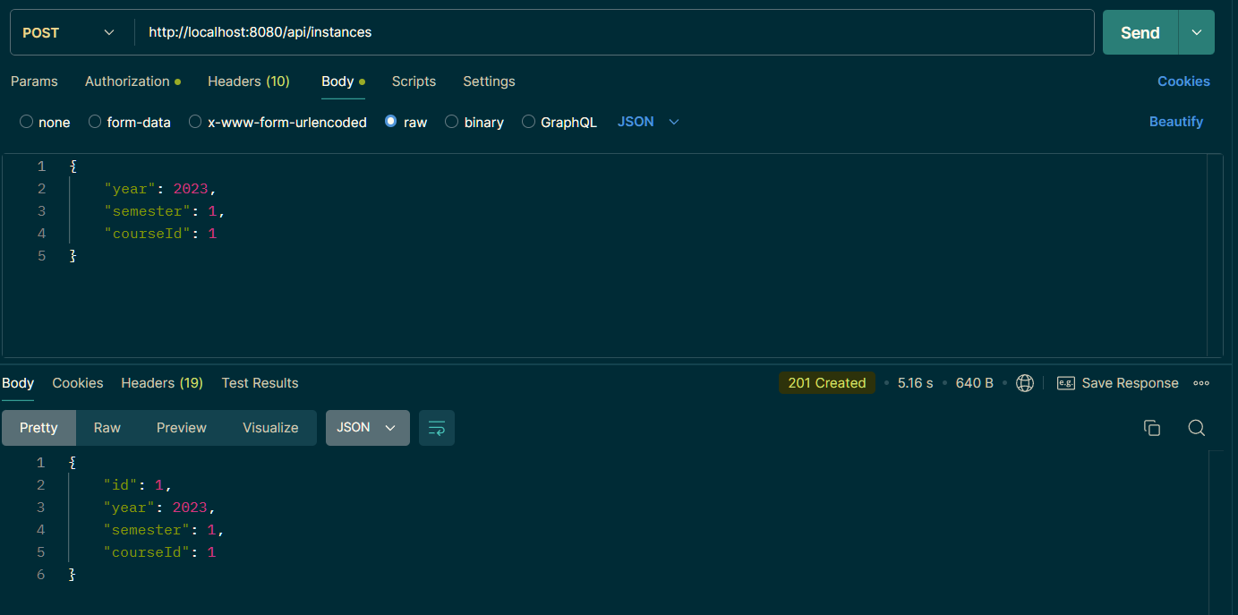

Slide 36
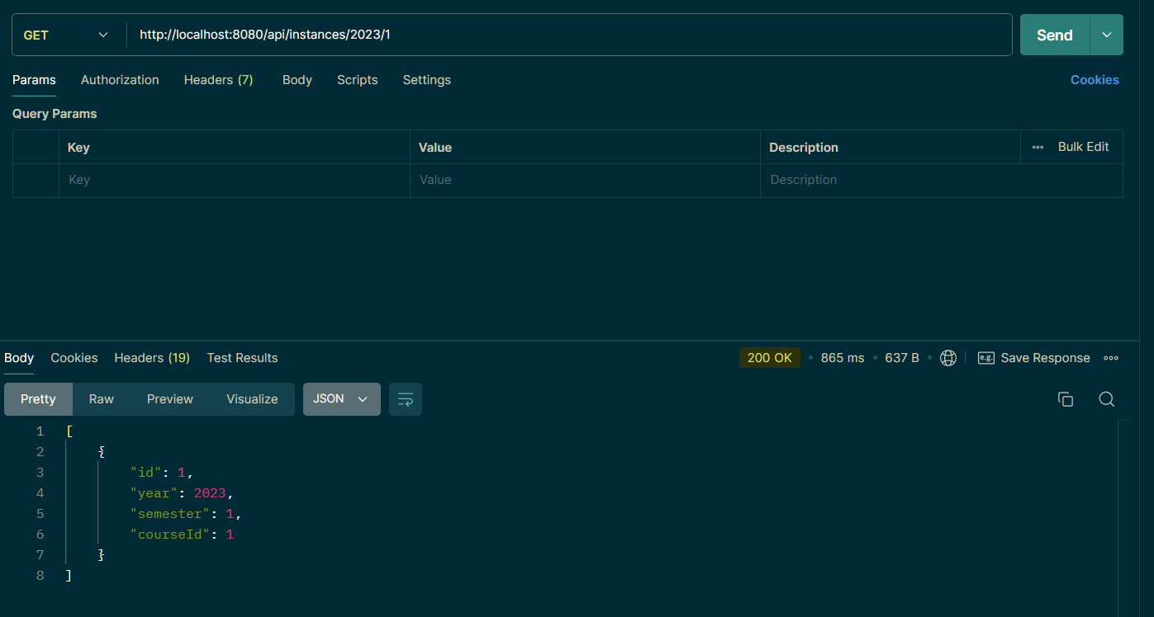

Slide 37
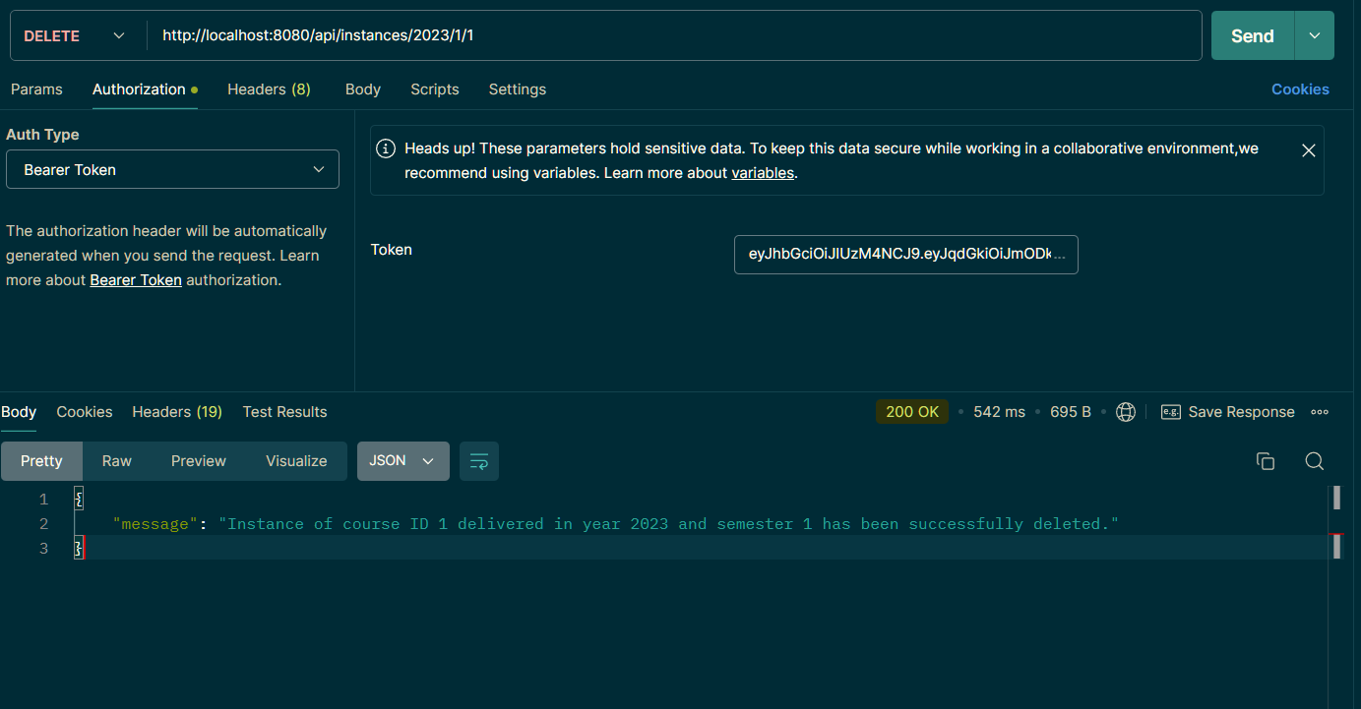

Slide 38
Config Server Overview
Centralized Configuration: Manages and serves configuration properties for microservices from a central location, ensuring consistent configuration across multiple instances.
Versioned Configuration: Supports versioned configuration management using Git or other version control systems, allowing for easy rollback and tracking of changes.
EnvironmentSpecific Profiles: Provides support for environmentspecific configuration profiles, enabling different configurations for development, staging, and production environments.
Dynamic Refresh: Enables dynamic updates to configuration without restarting services, utilizing Spring Cloud Bus (`/busrefresh`) for automatic refreshes.
Client Integration: Works seamlessly with Spring Boot applications, allowing clients to retrieve configuration properties at startup or through REST endpoints.

Slide 39


Slide 40


Slide 41


Slide 42


Slide 43


Slide 44
POST http://localhost:8888/actuator/busrefresh
traceId spanId
Spring Cloud Bus with Kafka as Message Broker

Slide 45
Security Testing with Spring Security and JWT
Token Creation: Securely generate tokens using strong algorithms and include necessary claims, ensuring they are both reliable and confidential.
Revoking Tokens: Manage token invalidation and expiration effectively to handle compromised or outdated tokens, and ensure correct status codes (e.g., 401 Unauthorized) are returned when necessary.
Authentication: Validate tokens rigorously to confirm authenticity and integrity, and handle status codes like 401 Unauthorized for failed authentications.
Authorization and RoleBased Access Control: Implement rolebased access by restricting access based on user roles, returning a 403 Forbidden status if an endpoint is accessed by unauthorized roles. Ensure that endpoints meant for admins are protected from nonadmin users, with the ability to handle refresh tokens if applicable.

Slide 46
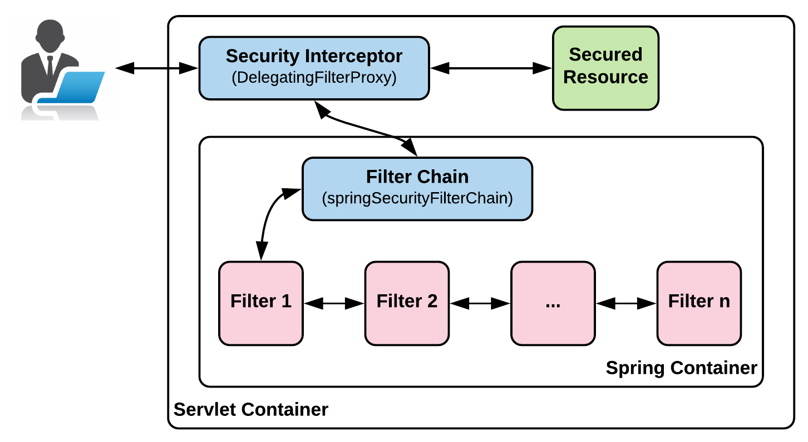

Slide 47
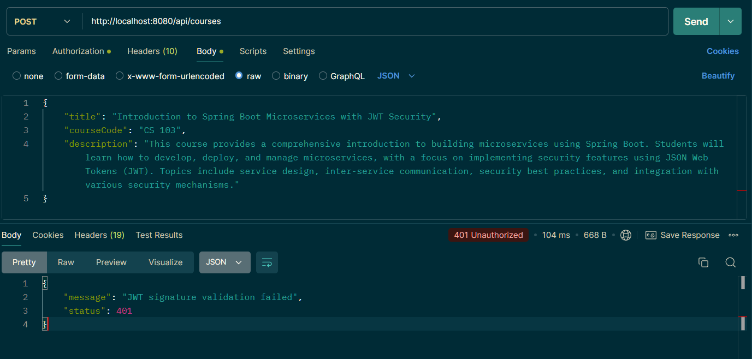

Slide 48
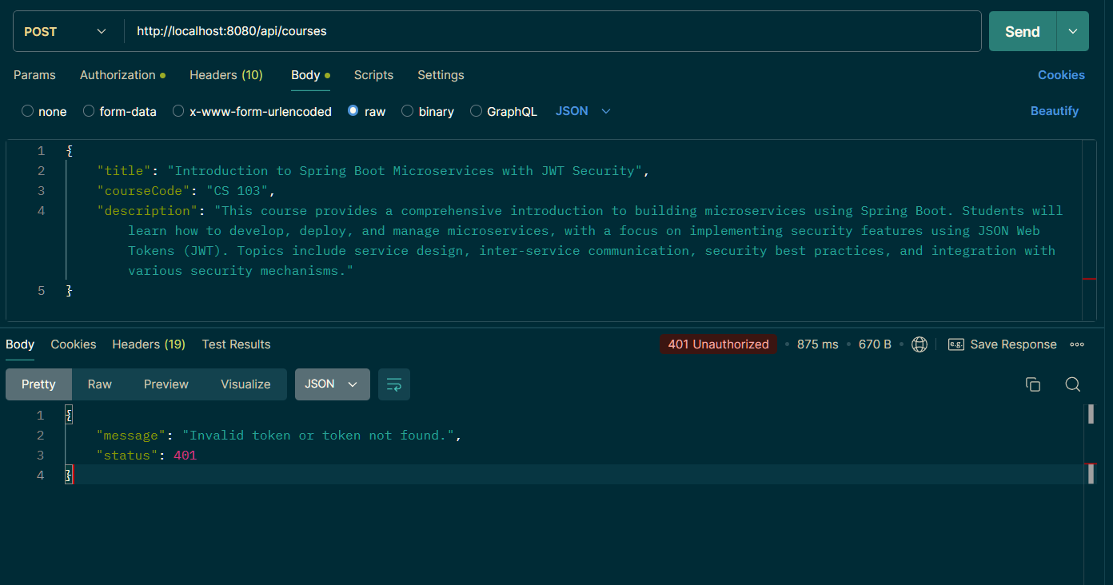

Slide 49
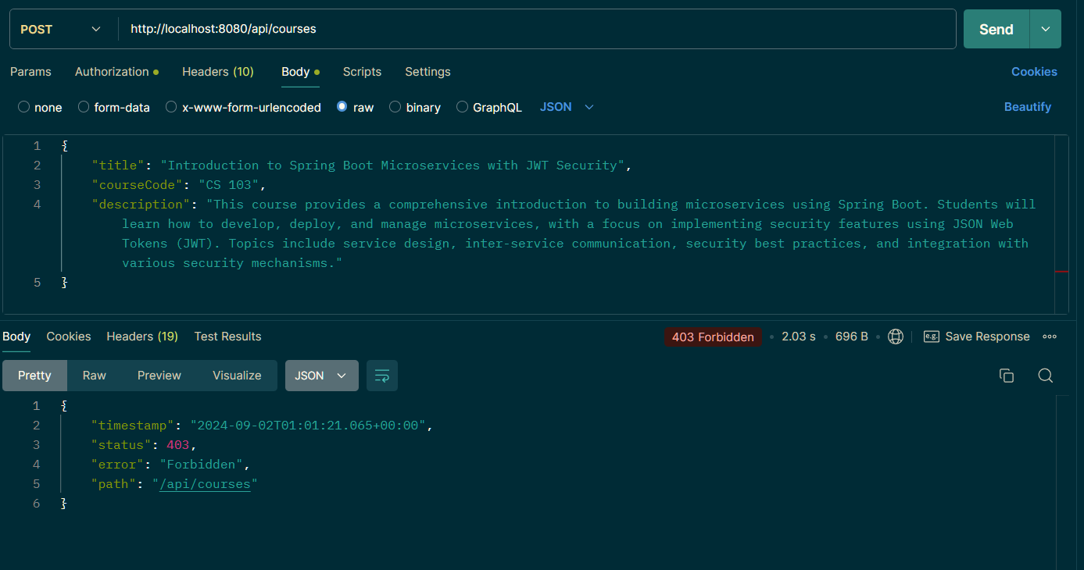

Slide 50
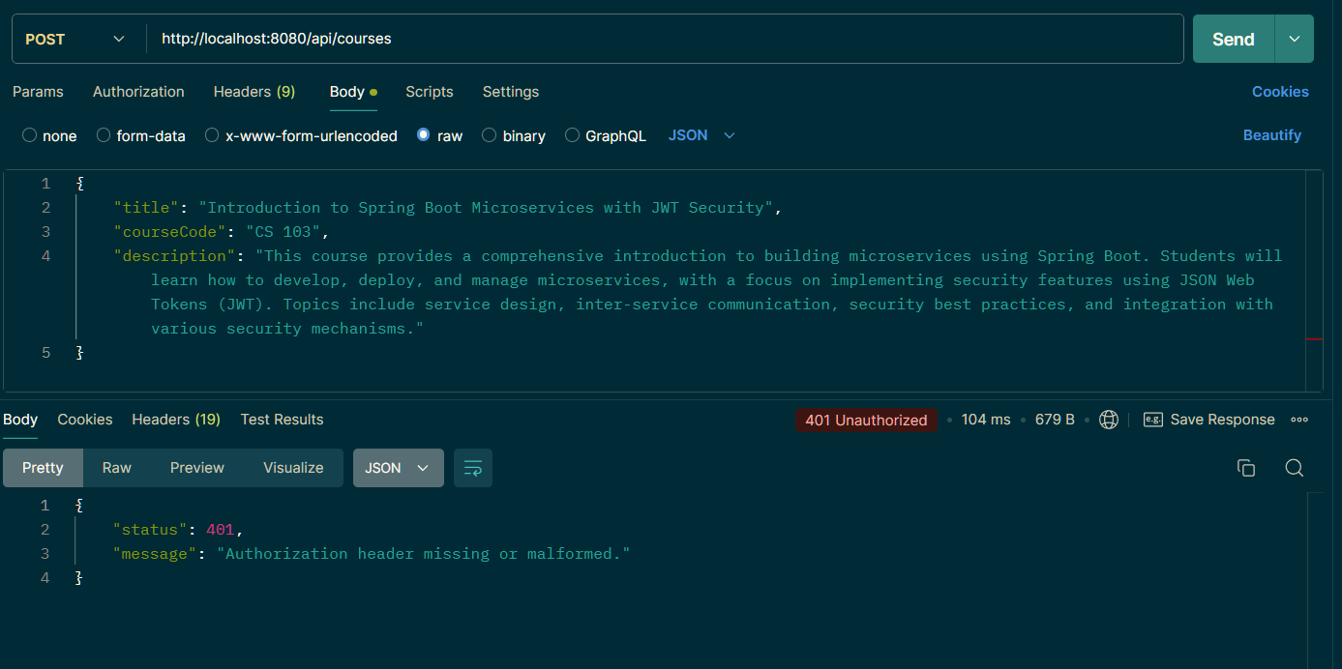

Slide 51
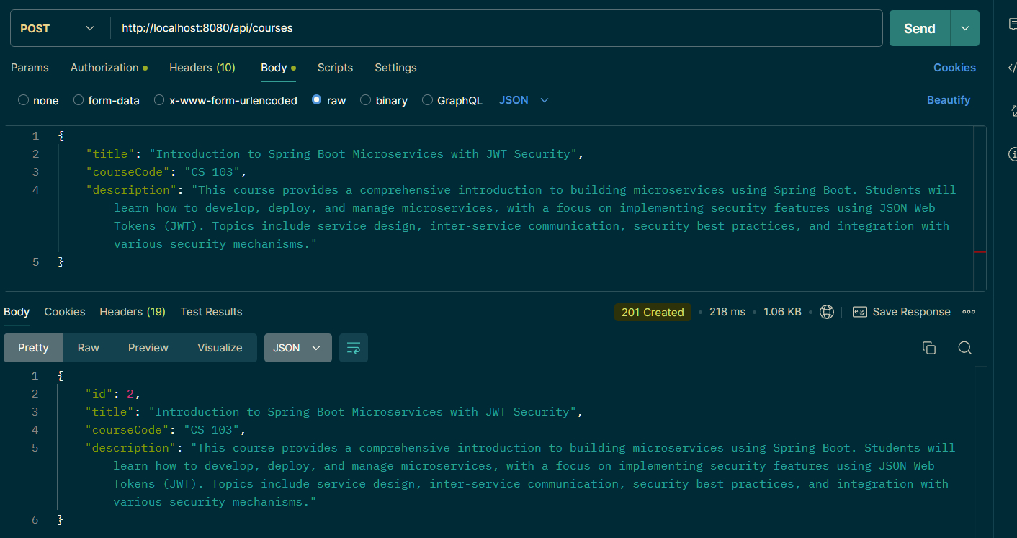

Slide 52
End-to-End Request Tracking with Zipkin
End-to-End Visibility: Zipkin provides comprehensive tracing of requests across multiple services, offering full visibility into the entire request lifecycle from initiation to completion.
Trace Correlation: Automatically correlates requests across microservices by linking trace IDs, allowing for seamless tracking of transactions across distributed systems.
Latency Analysis: Identifies performance bottlenecks and latency issues by visualizing the time taken at each service and pinpointing delays in the request flow.
Detailed Insights: Offers detailed insights into service interactions, including timestamps and latency, enabling indepth analysis of service performance and troubleshooting.
Visual Trace Maps: Provides visual maps of trace data, making it easier to understand the flow of requests and interactions between microservices through intuitive graphical representations.

Slide 53
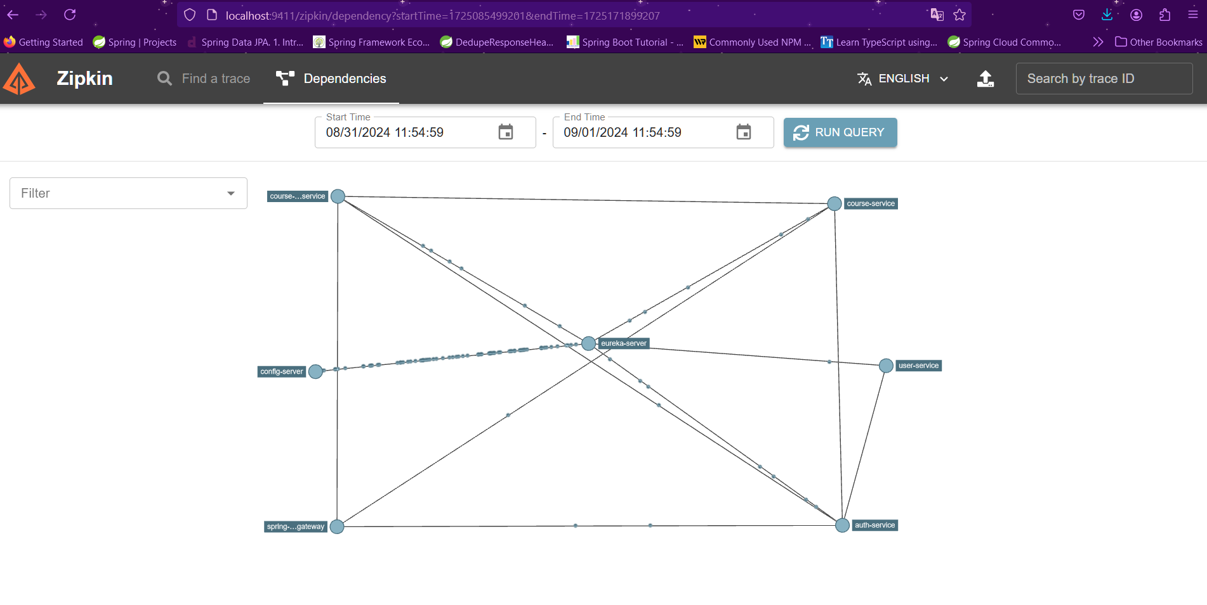

Slide 54
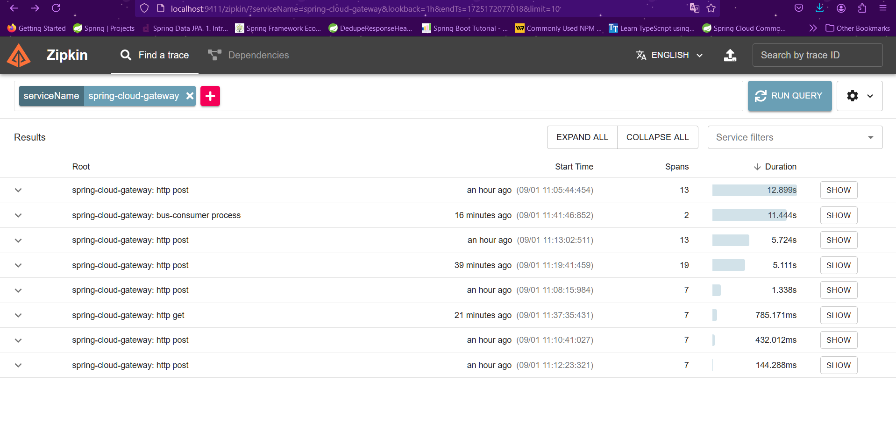

Slide 55
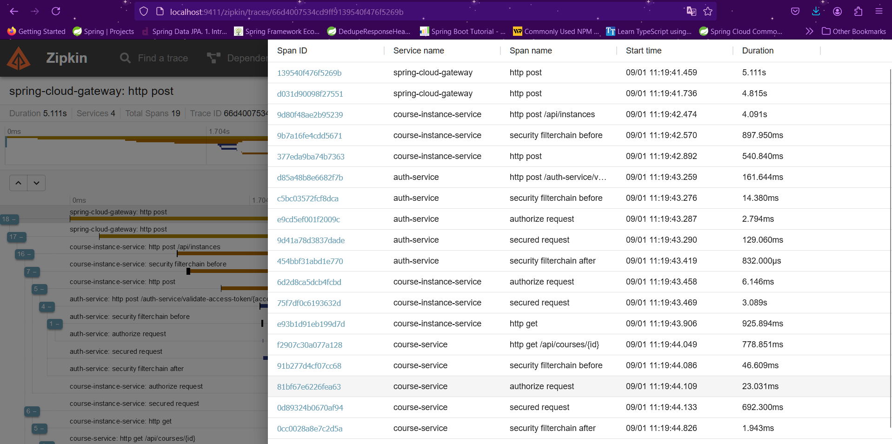

Slide 56
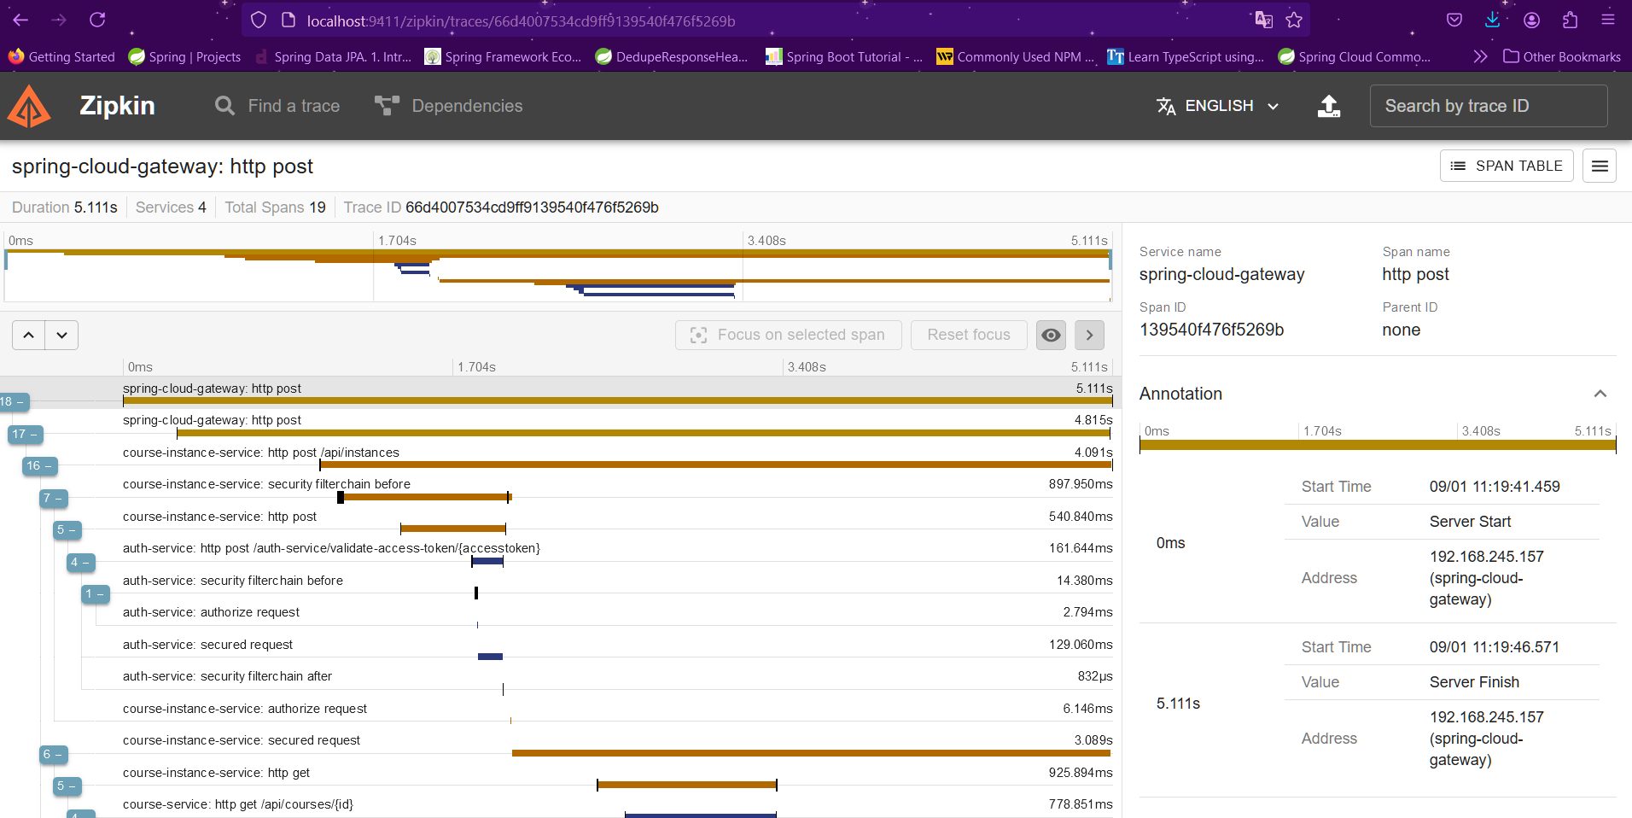

Slide 57
Optimizing Performance with Redis as a Cache
HighSpeed Data Retrieval: Redis significantly reduces data access times by storing frequently accessed data in memory, enabling faster response times for applications.
Scalability and Flexibility: Redis supports horizontal scaling, allowing seamless cache scaling as application demand grows, ensuring consistent performance.
Persistent Caching: Redis offers options for data persistence, ensuring cached data can survive restarts and power failures.
Advanced Data Structures: Redis supports various data types, such as strings, lists, sets, and hashes, making it versatile for different caching strategies.
Cache Expiration and Eviction: Redis provides finegrained control over cache expiration policies, allowing for automatic eviction of stale data and efficient memory management.

Slide 58
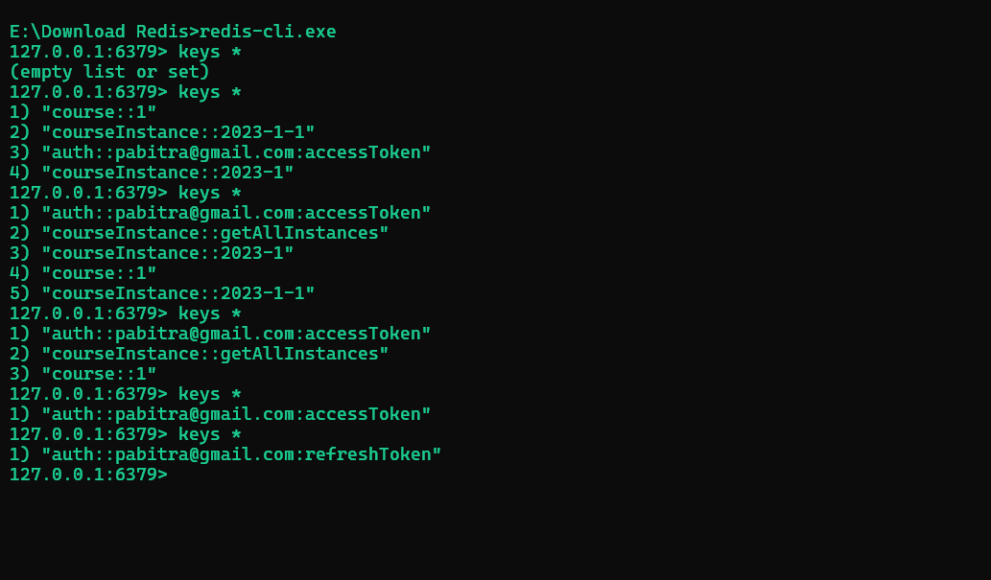

Slide 59
Enhancing Reliability with Resilience4j
Fault Tolerance: Resilience4j Circuit Breaker protects your system from cascading failures by monitoring and controlling the interaction between distributed services, automatically stopping calls to failing services.
Dynamic Configuration: Provides flexible configuration options, allowing the adjustment of thresholds for failures, timeouts, and automatic retries based on realtime performance metrics.
Recovery and Stability: Automatically transitions from an "Open" state (blocking calls) to a "HalfOpen" state (testing if the service has recovered) before fully closing the circuit, ensuring service stability and smooth recovery.
Customizable Response Handling: Allows developers to define fallback methods and error handling strategies, enabling graceful degradation of service in the event of a failure.
Rate Limiting and Bulkheading: Alongside circuit breaking, Resilience4j offers rate limiting and bulkhead patterns to manage load and prevent resource exhaustion, enhancing overall system resilience.

Slide 60
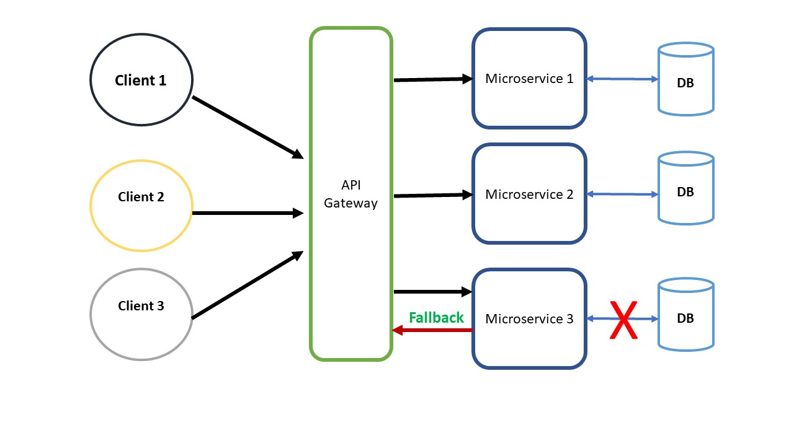

Slide 61
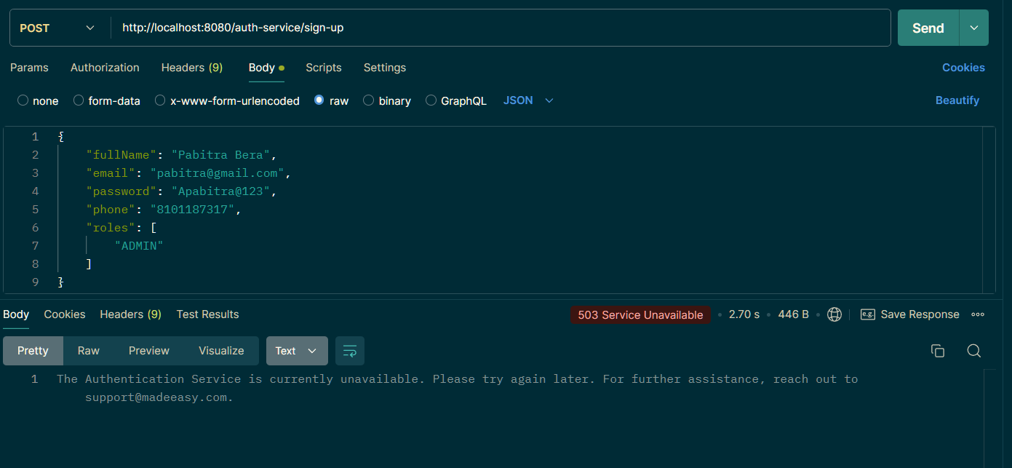

Slide 62
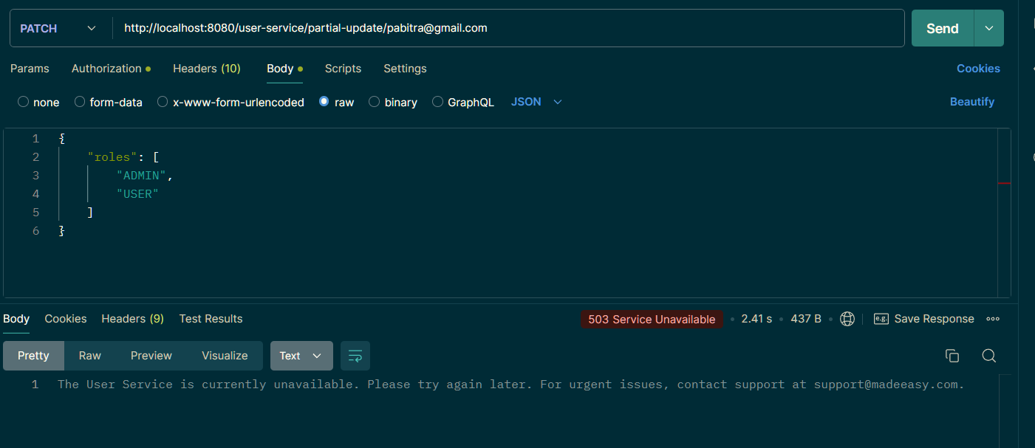

Slide 63
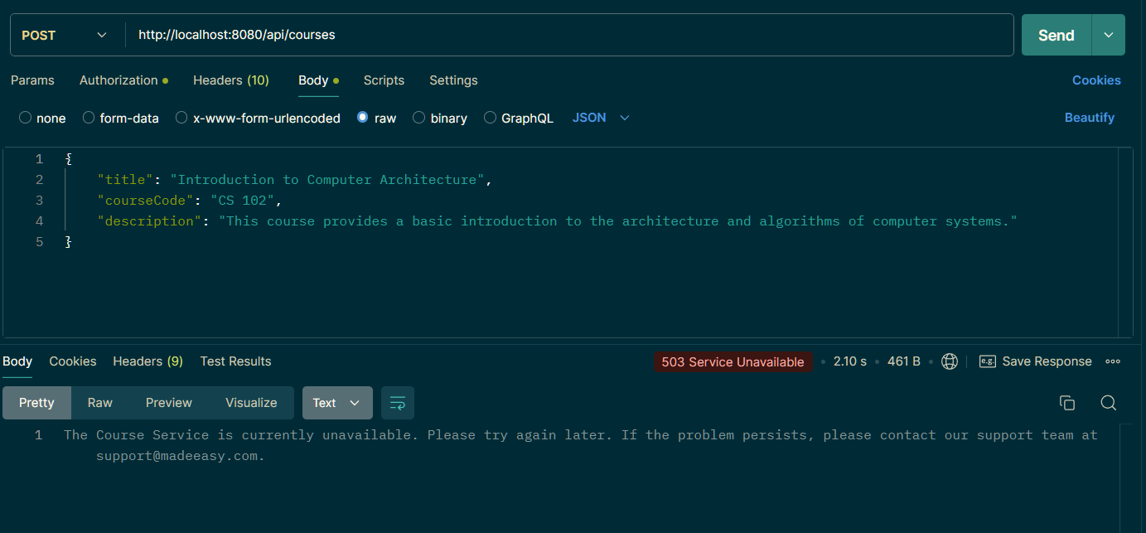

Slide 64
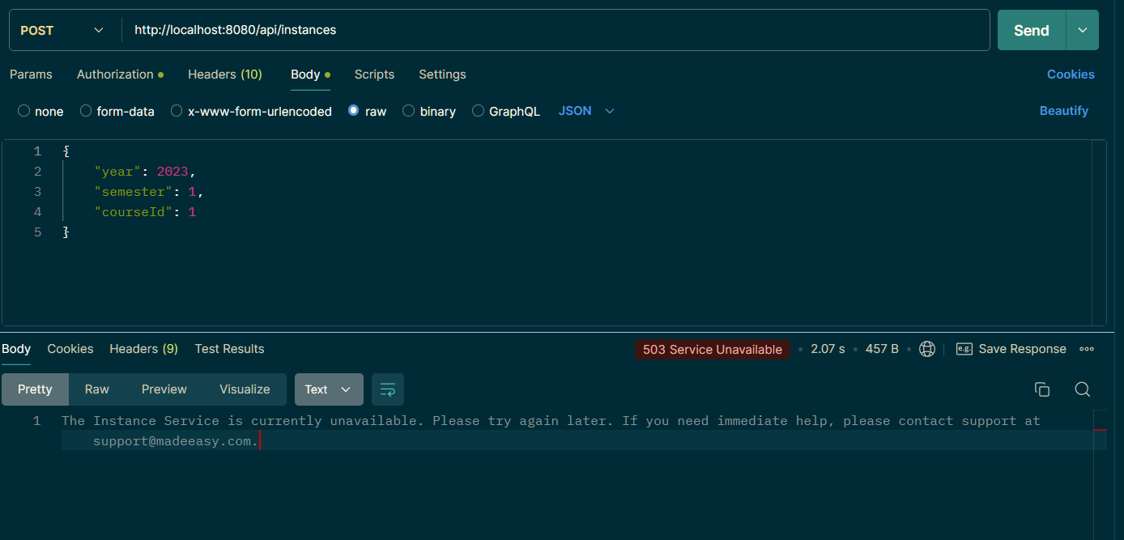

Slide 65
ReactJS Frontend for Course Management System
Responsive Design: The interface is fully responsive, ensuring optimal usability across all device sizes, from desktops to mobile devices.
User SignUp and Login: Provides smooth and intuitive signup and login flows, allowing users to easily create accounts and access the platform.
RoleBased Access Control: Implements rolebased access control, where the interface dynamically adjusts based on whether the user is an admin or a regular user, displaying the appropriate features and restrictions.
Seamless Integration with Spring Boot Microservices: The ReactJS frontend is tightly integrated with the Spring Boot microservices backend, ensuring consistent and reliable data management and interactions.

Slide 66
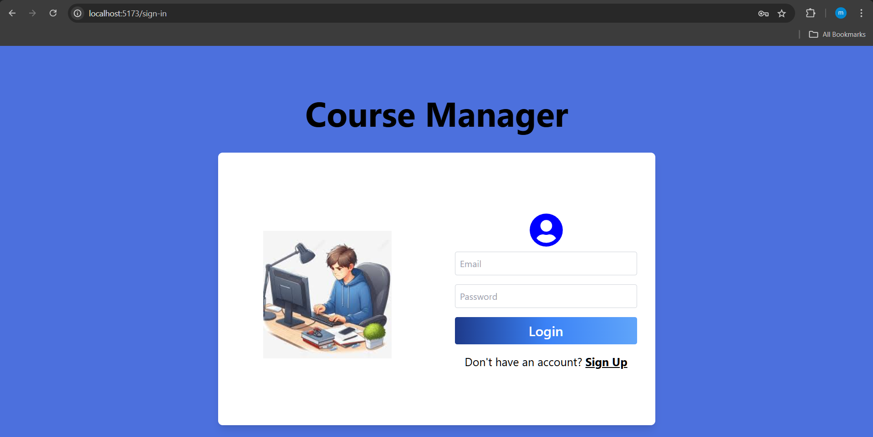

Slide 67
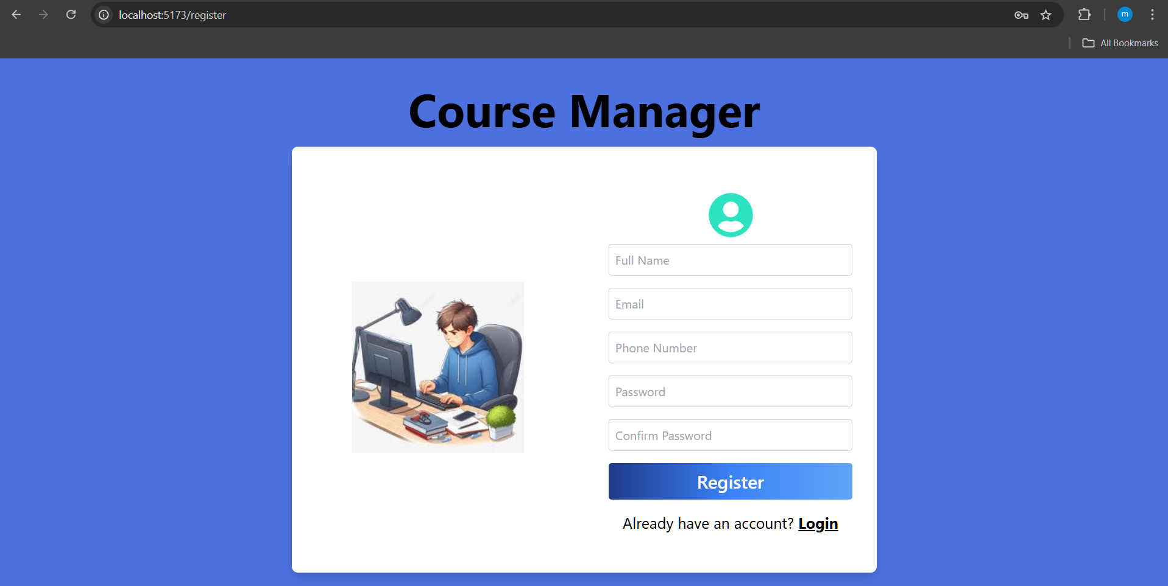

Slide 68
User Dashboard
Course and Instance Viewing: Users have access to view a comprehensive list of available courses and their instances, providing them with detailed information.
Restricted Actions: Users are limited to readonly access, meaning they cannot create, delete, or modify courses and instances, ensuring data integrity and security.
UserCentric Design: The interface is tailored to provide users with a clear and accessible overview of their enrolled courses, without exposing administrative functionalities.
Simplified Interaction: Focuses on delivering an intuitive and straightforward experience, where users can easily navigate through their courses without the complexity of administrative controls.

Slide 69
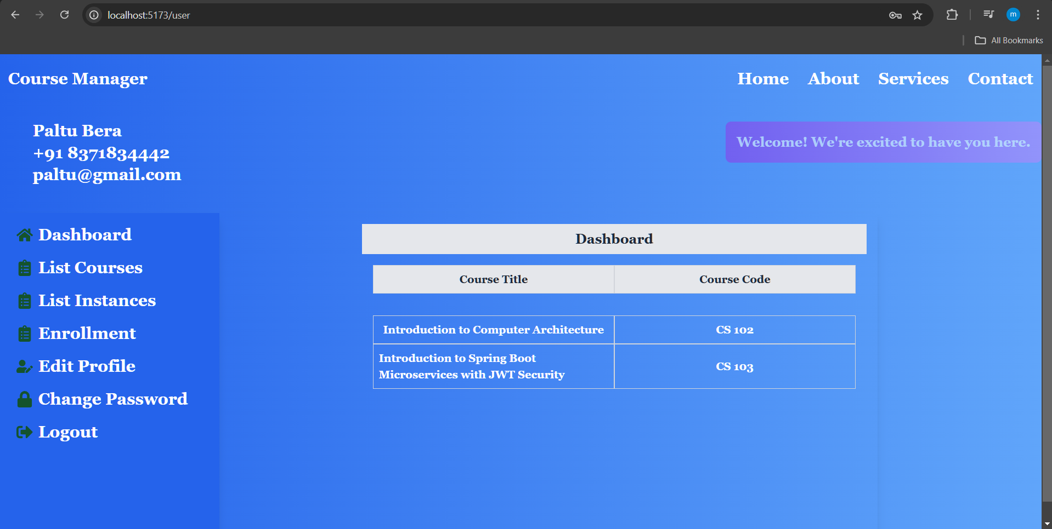

Slide 70


Slide 71
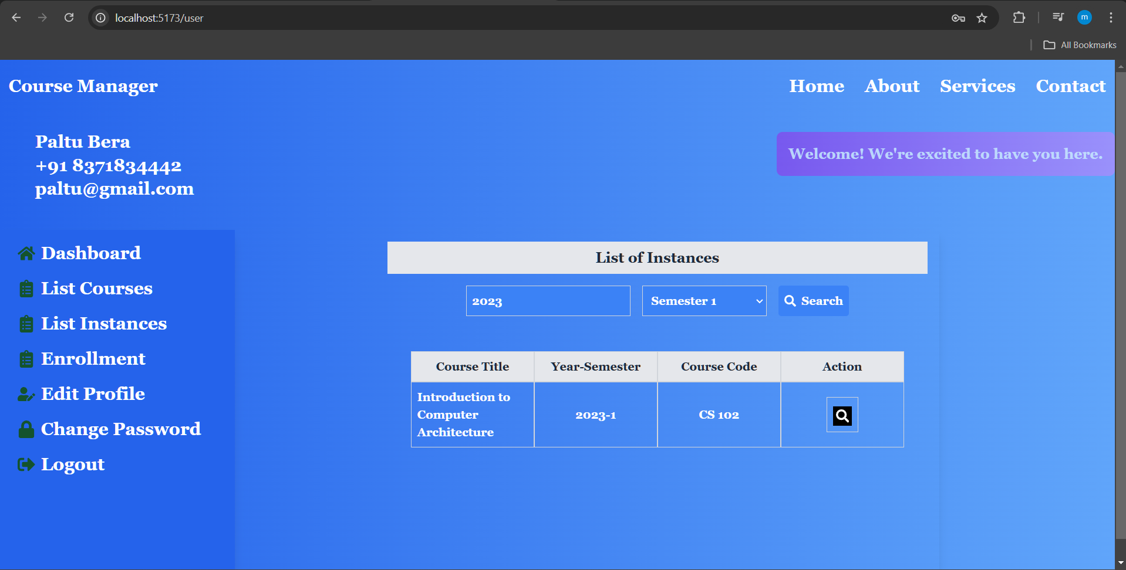

Slide 72
Common User and Admin Functionalities
Profile Management: Both users and admins have access to edit their profiles, allowing them to update personal information like name, email, and contact details.
Password Update: Secure options are provided for changing passwords, ensuring that both user and admin accounts remain protected with uptodate credentials.
Logout Functionality: A seamless logout feature is available for both roles, ensuring they can safely exit their sessions and maintain account security.

Slide 73
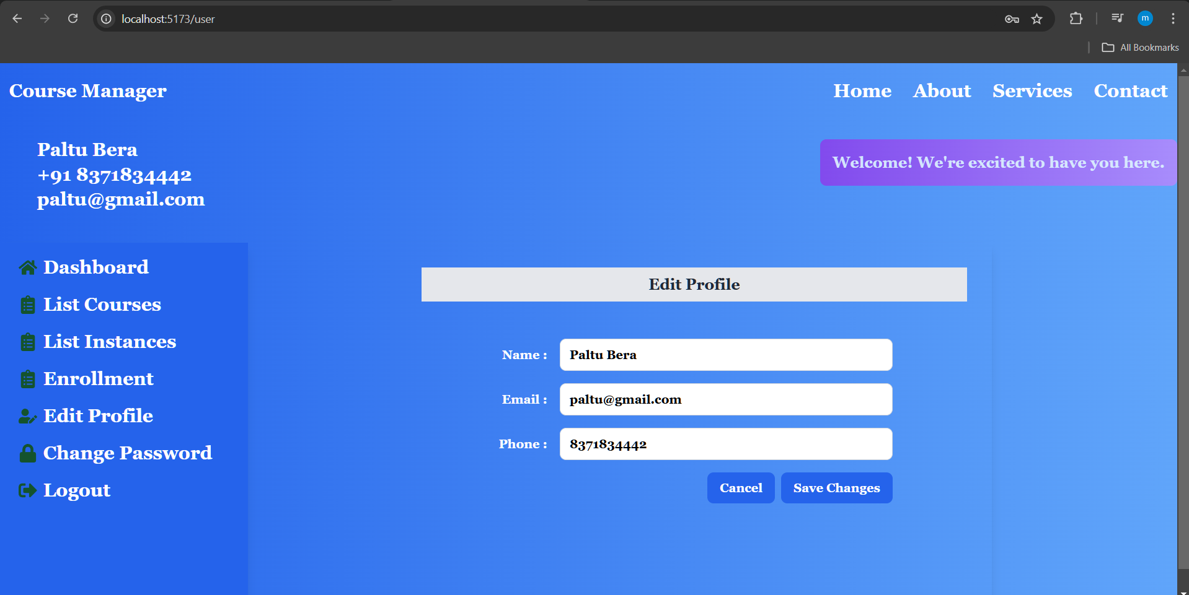

Slide 74
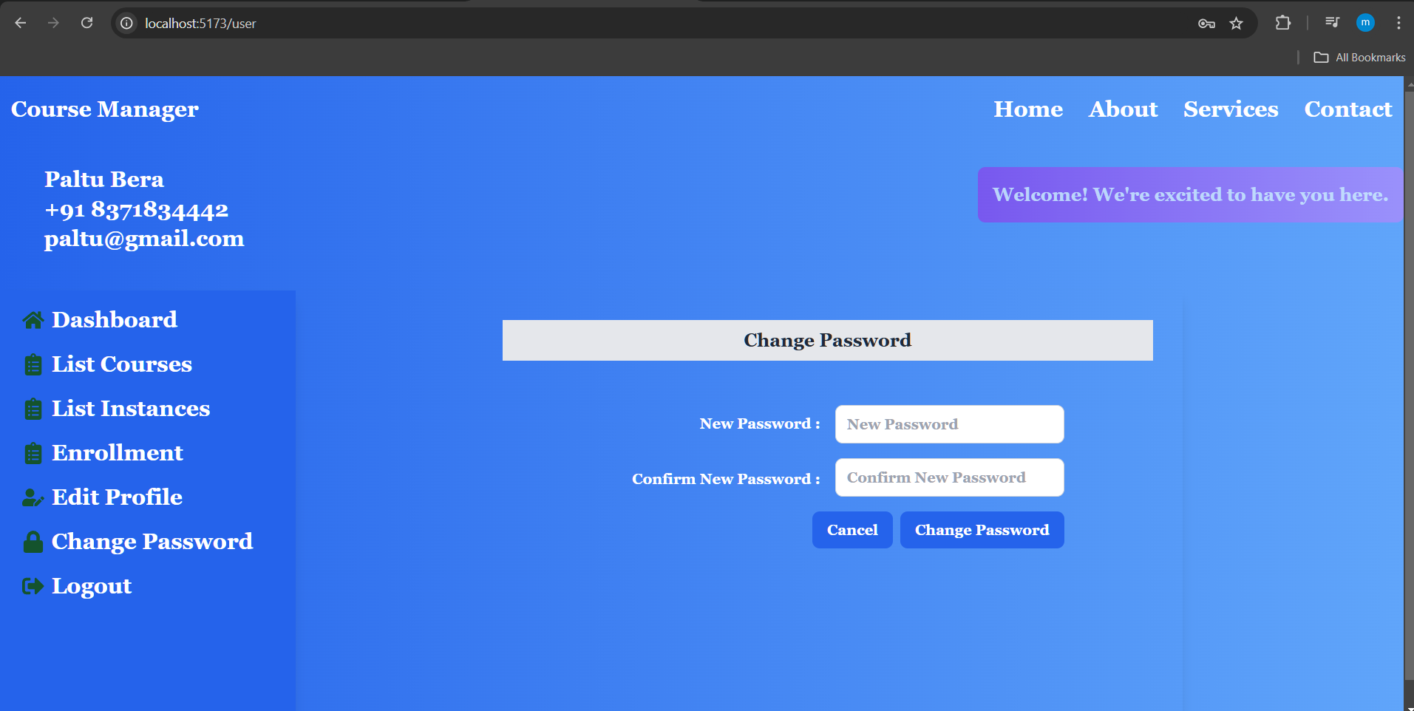

Slide 75


Slide 76
Admin Dashboard
Full Management Access: Admins have complete control over course and instance management, including the ability to create, delete, and update courses and their instances.
Enhanced Functionality: The dashboard is equipped with tools and options for admins to efficiently manage and oversee all courserelated activities, ensuring smooth operation and organization.
RoleBased Permissions: Admins are granted exclusive permissions to modify course content, reflecting their elevated role within the system, while ensuring that only authorized users can make significant changes.
Advanced Controls: The interface offers comprehensive features for course and instance management, tailored to meet the needs of administrators, enabling detailed oversight and maintenance of the system’s educational resources.

Slide 77


Slide 78


Slide 79


Slide 80


Slide 81


Slide 82
Automating Docker Image Creation and Deployment
Maven Configuration: Integrated the `jib-maven-plugin` into the multimodule Spring Boot project to automate Docker image creation and management.
Base Image Selection: Selected `eclipse-temurin:21-jre-jammy` as the base image to ensure compatibility with Java 21.
Image Configuration: Configured the `jib-maven-plugin` to define the Docker image registry and naming convention (`registry.hub.docker.com/pabitrabera2001/${project.artifactId}`) for efficient versioning and storage.
Automated Build and Push: Executed `mvn clean compile jib:build`, which automatically built the Docker image and pushed it to the specified Docker repository without needing a Dockerfile.
Streamlined Deployment: This process simplifies CI/CD pipelines by automating Docker image creation and deployment, ensuring consistency across environments.

Slide 83

mvn clean compile jib:build

Slide 84

docker build -t pabitrabera2001/course-manager-front-end .
docker push pabitrabera2001/course-manager-front-end

Slide 85
Docker Compose Setup
Location: The docker-compose.yml file is hosted in the GitHub repository: https://github.com/madeeasycodinglife/edu-course-manager-backend/blob/main/docker-compose.yml
Start : Used `docker-compose up -d` to start services in detached mode, running containers in the background.
Stop: Used `docker-compose down` to stop and remove the containers when needed.

Slide 86


